Slide 1
The Abel Carrasco and Alonso Monarrez (ACAM) University Bank
Team Members:
Abel Carrasco
Alonso Monarrez

Slide 2
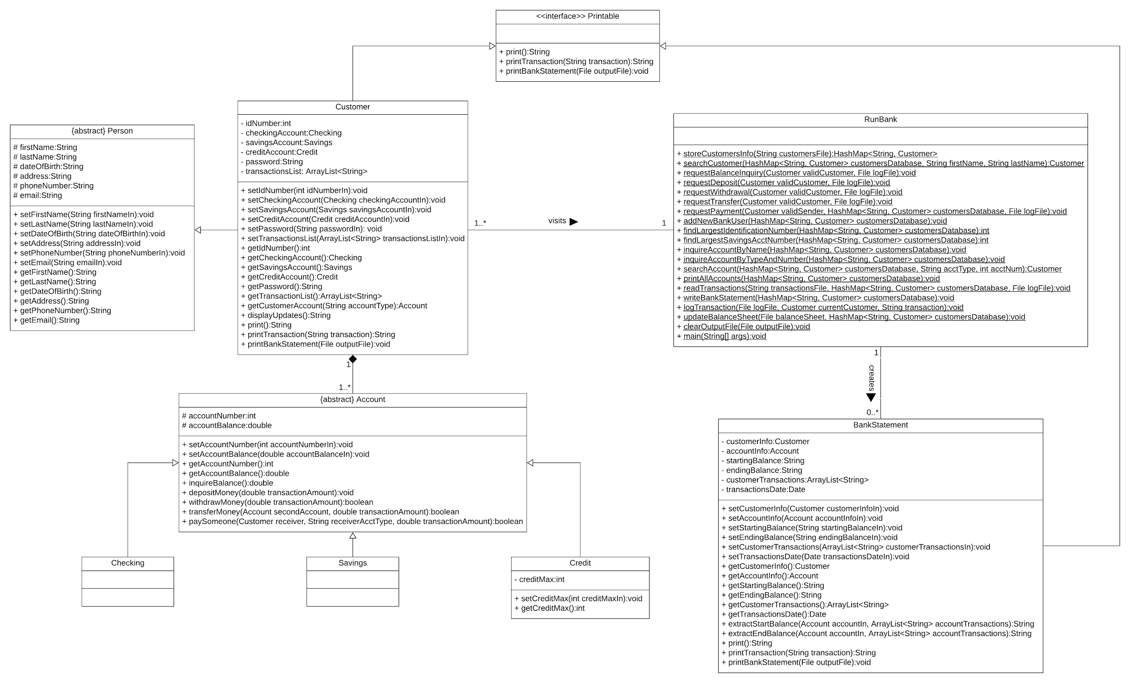
UML Class Diagram

Slide 3
How did we use Object-Oriented Programming?
We used Object-Oriented Programming by applying inheritance of the superclasses to their respective subclasses in order to acquire all of the attributes and behaviors from the parent class without the need to re-define in every single subclass.
Additionally, we used constructors, including the default constructor, setters, and getters throughout the course of our program to initialize objects of a class, assign values to them, and retrieve those values, respectively.
Lastly, we accounted for the open-closed principle, by which our code was open for extension but closed for modification. That way, we were able to add more functionality to our previously defined methods and classes in order to accommodate new functionalities.

Slide 4
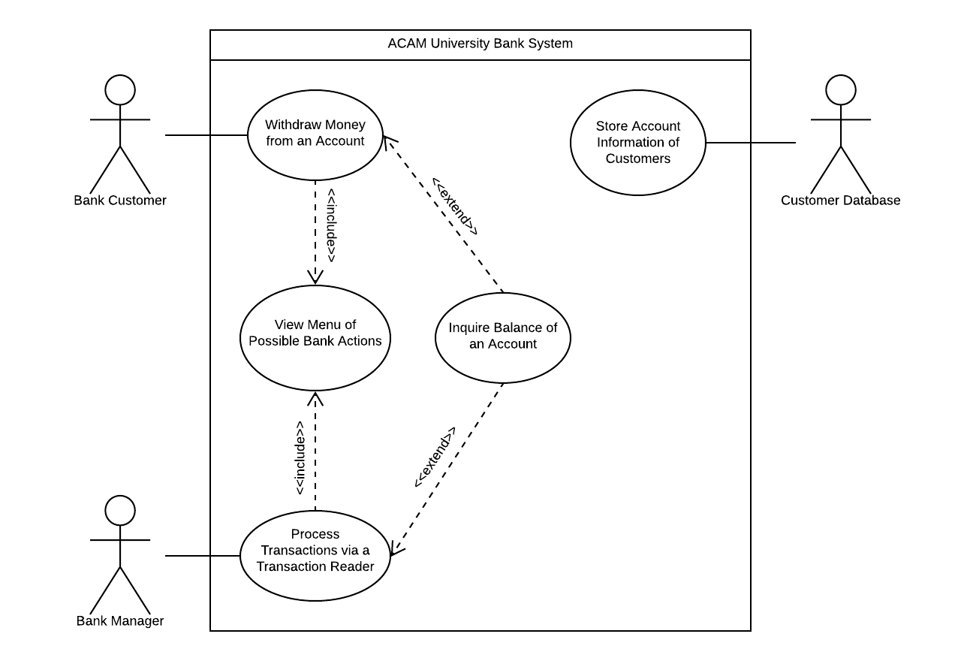
UML Use Case Diagram

Slide 5
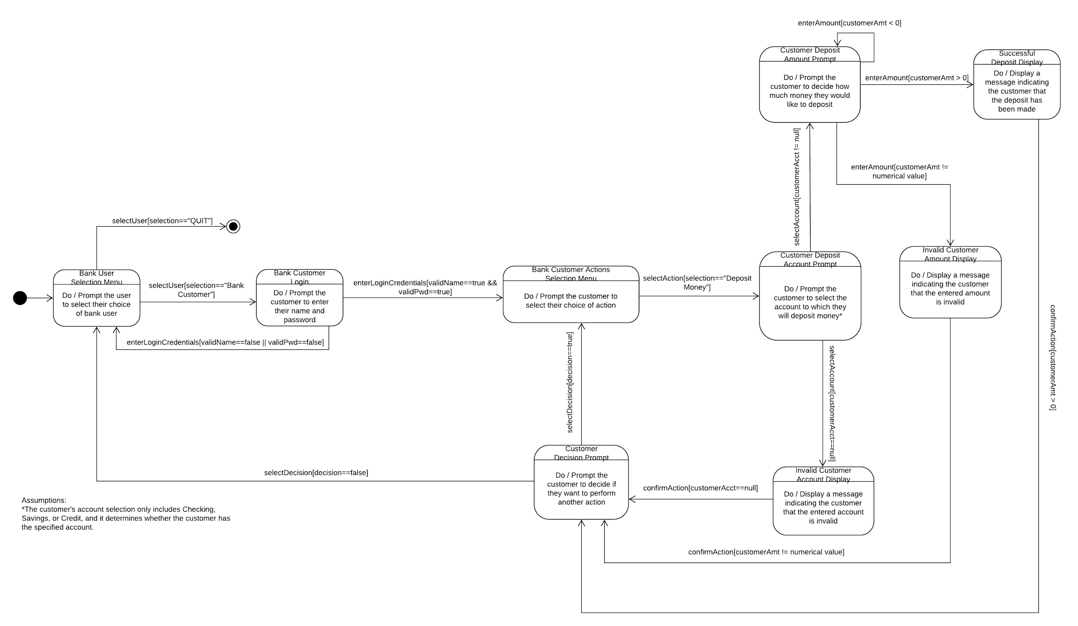
UML State Diagram

Slide 6
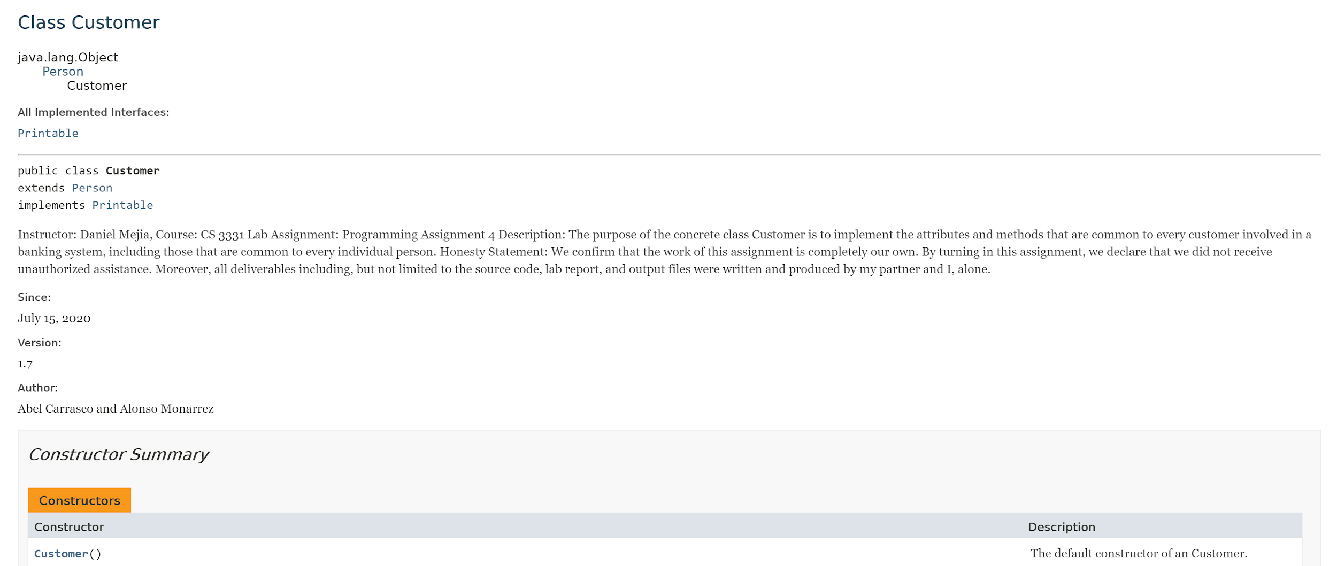
Javadoc - Customer (Part 1)

Slide 7
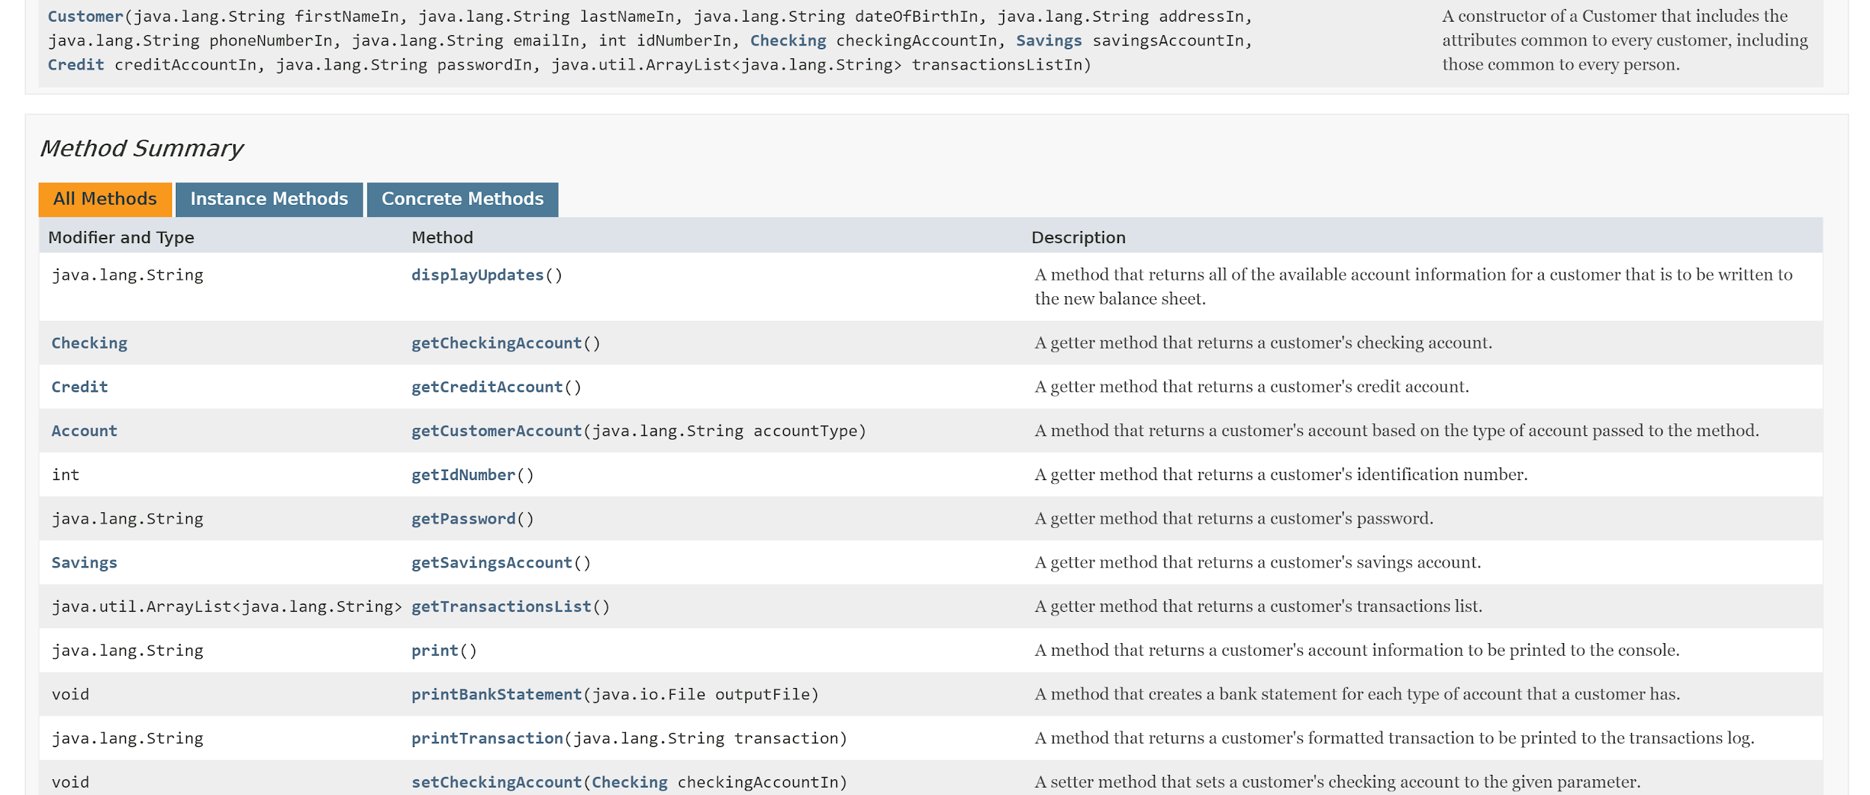
Javadoc - Customer (Part 2)

Slide 8
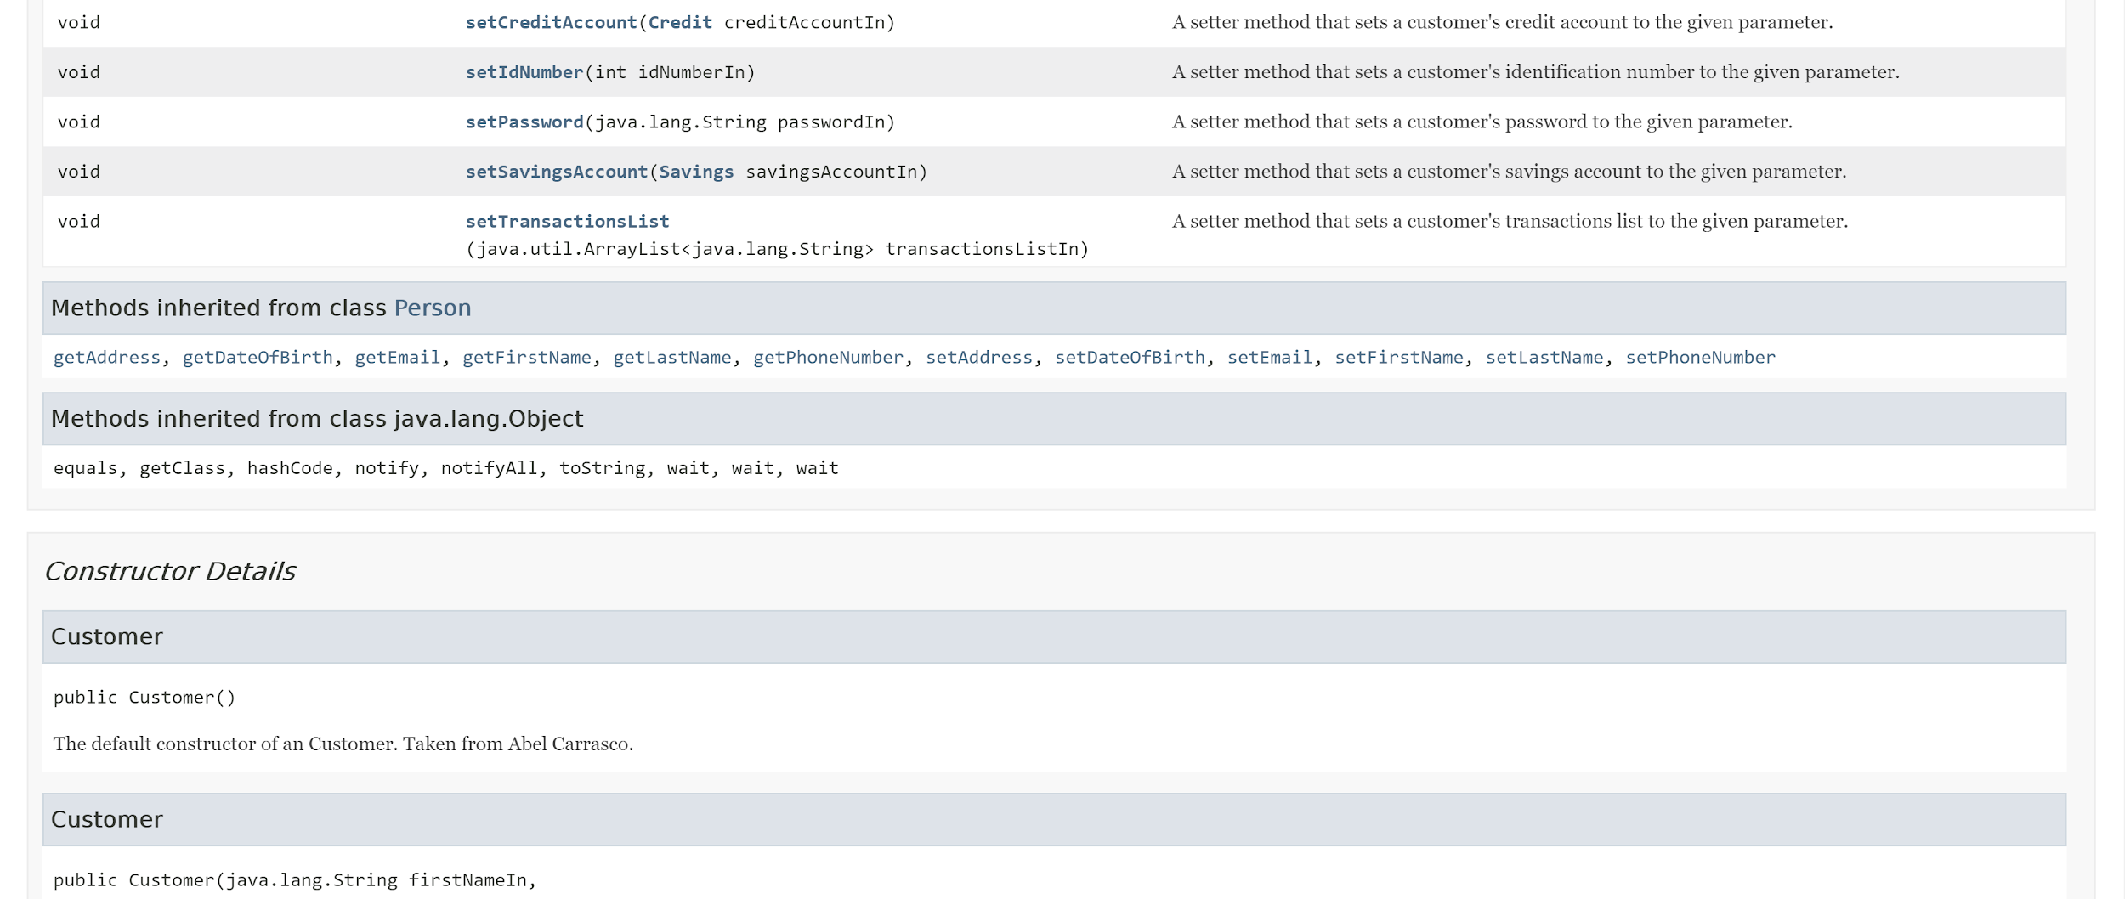
Javadoc - Customer (Part 3)

Slide 9
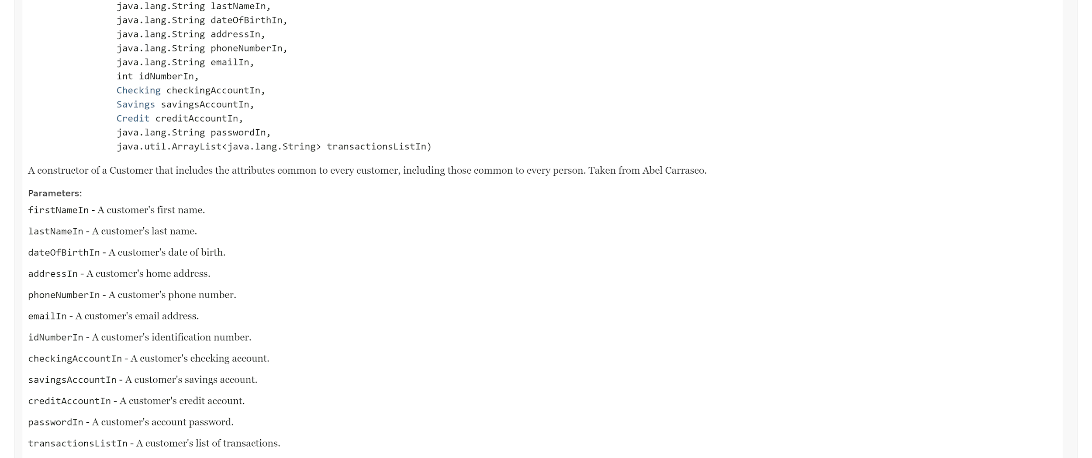
Javadoc - Customer (Part 4)

Slide 10
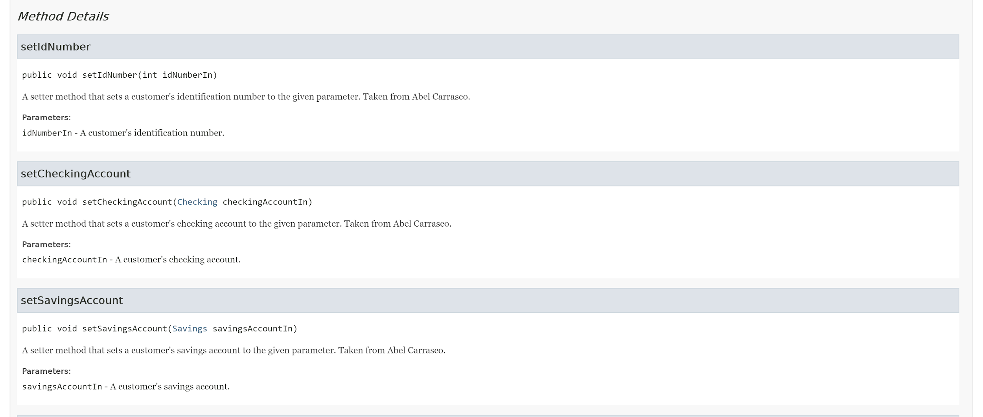
Javadoc - Customer (Part 5)

Slide 11
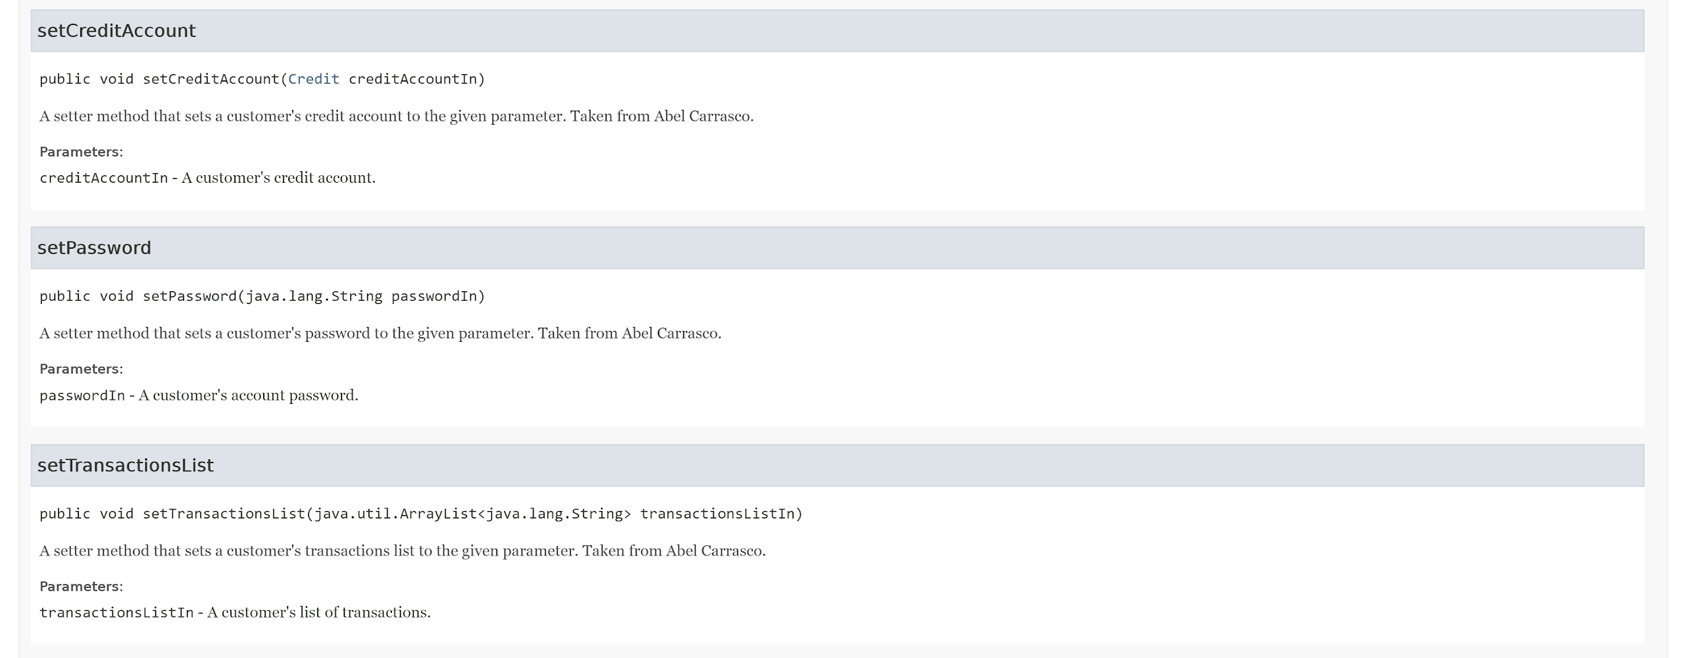
Javadoc - Customer (Part 6)

Slide 12
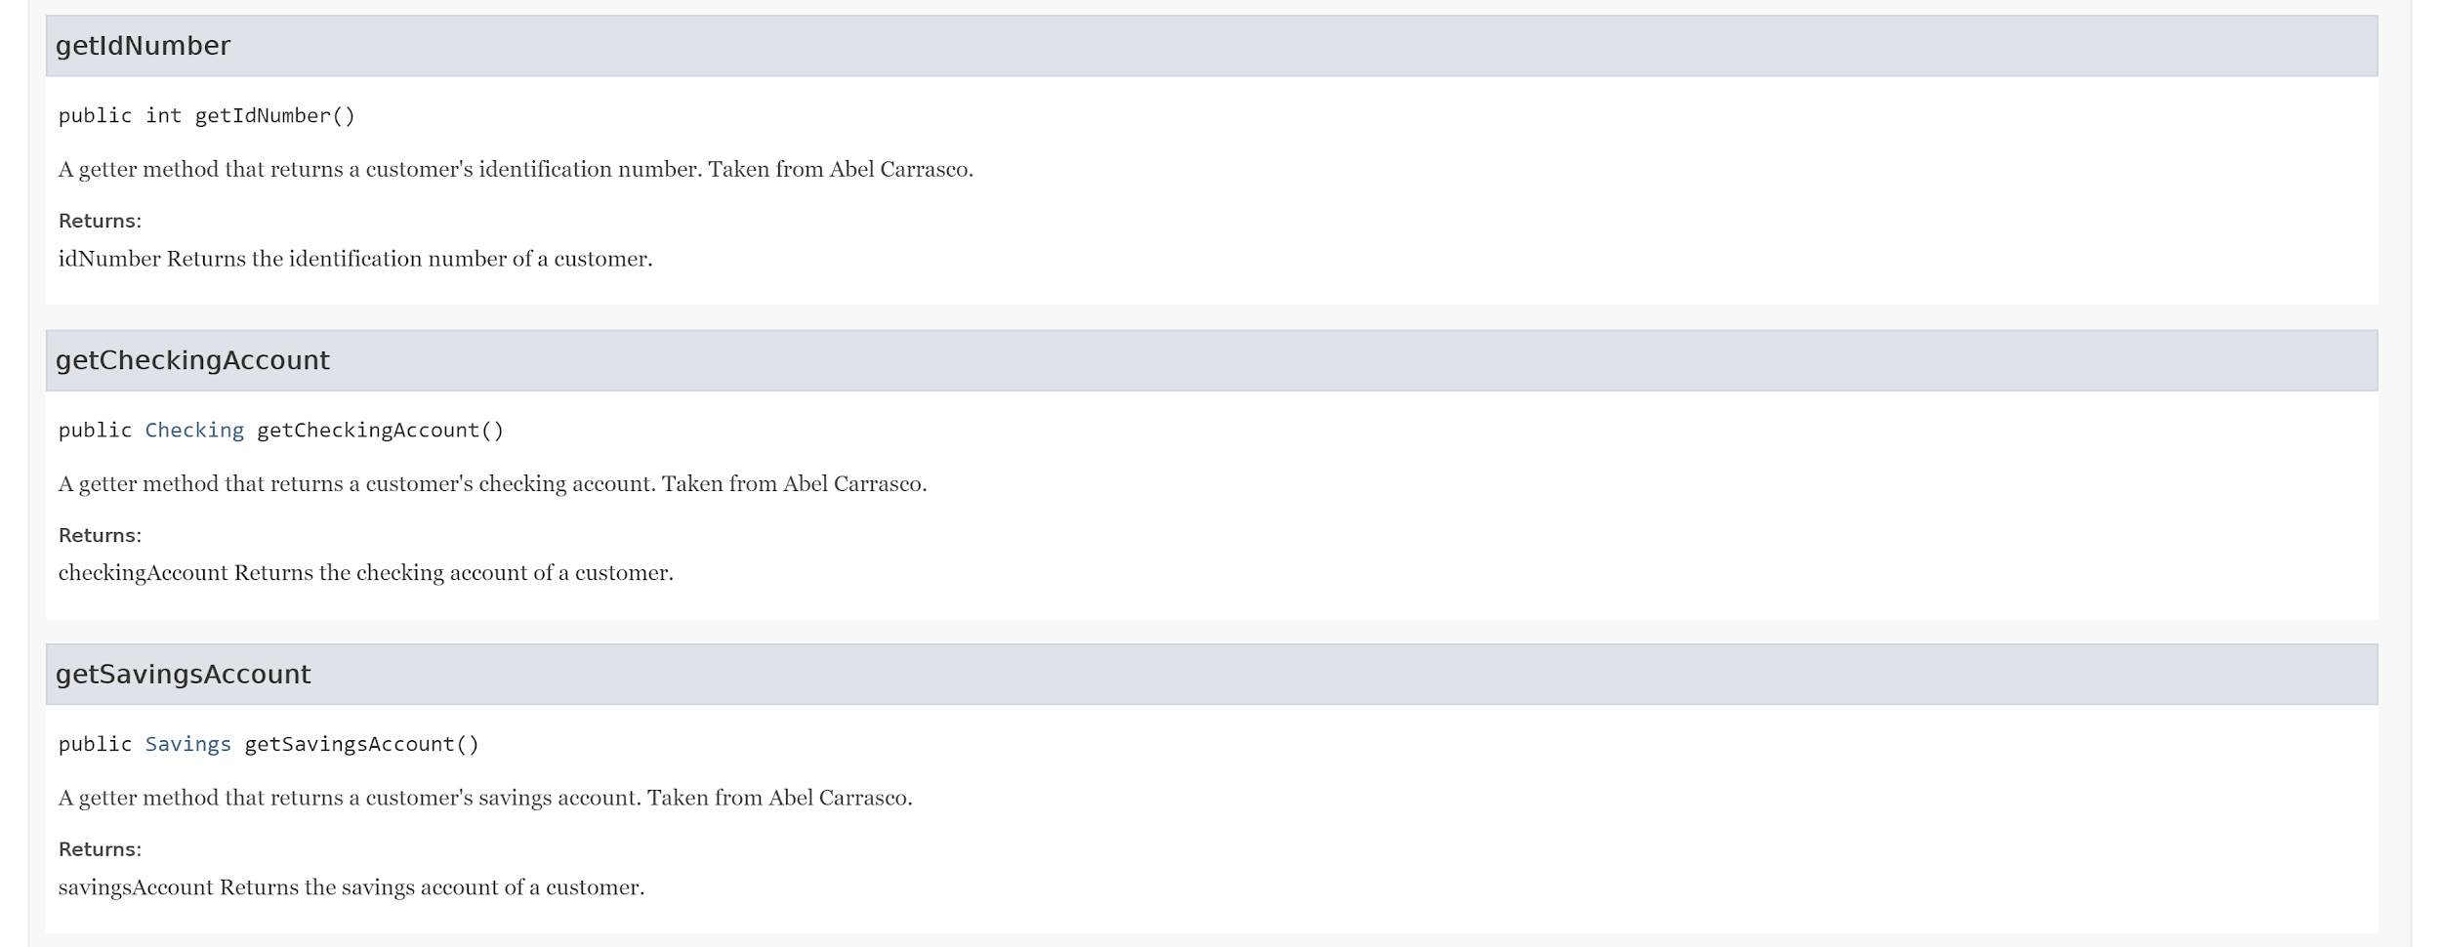
Javadoc - Customer (Part 7)

Slide 13
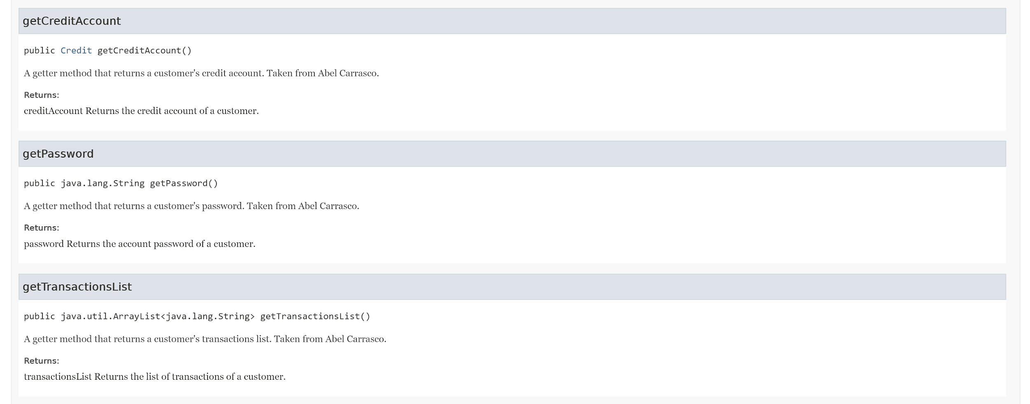
Javadoc - Customer (Part 8)

Slide 14
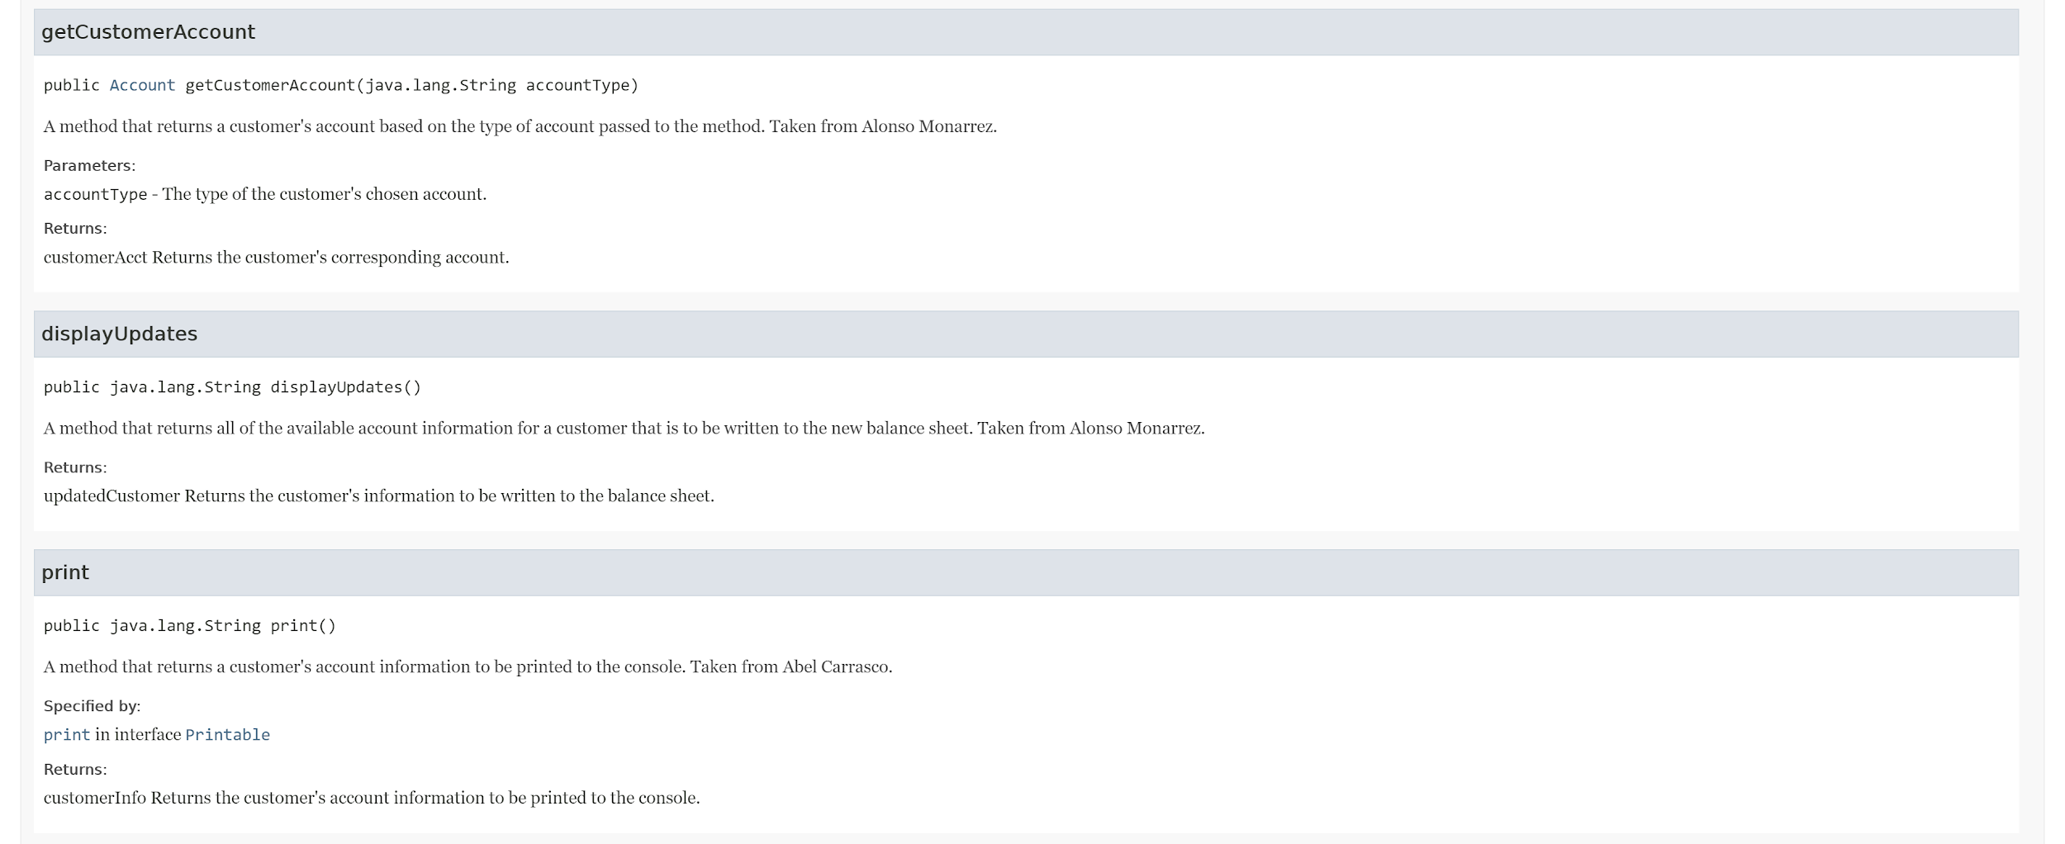
Javadoc - Customer (Part 9)

Slide 15
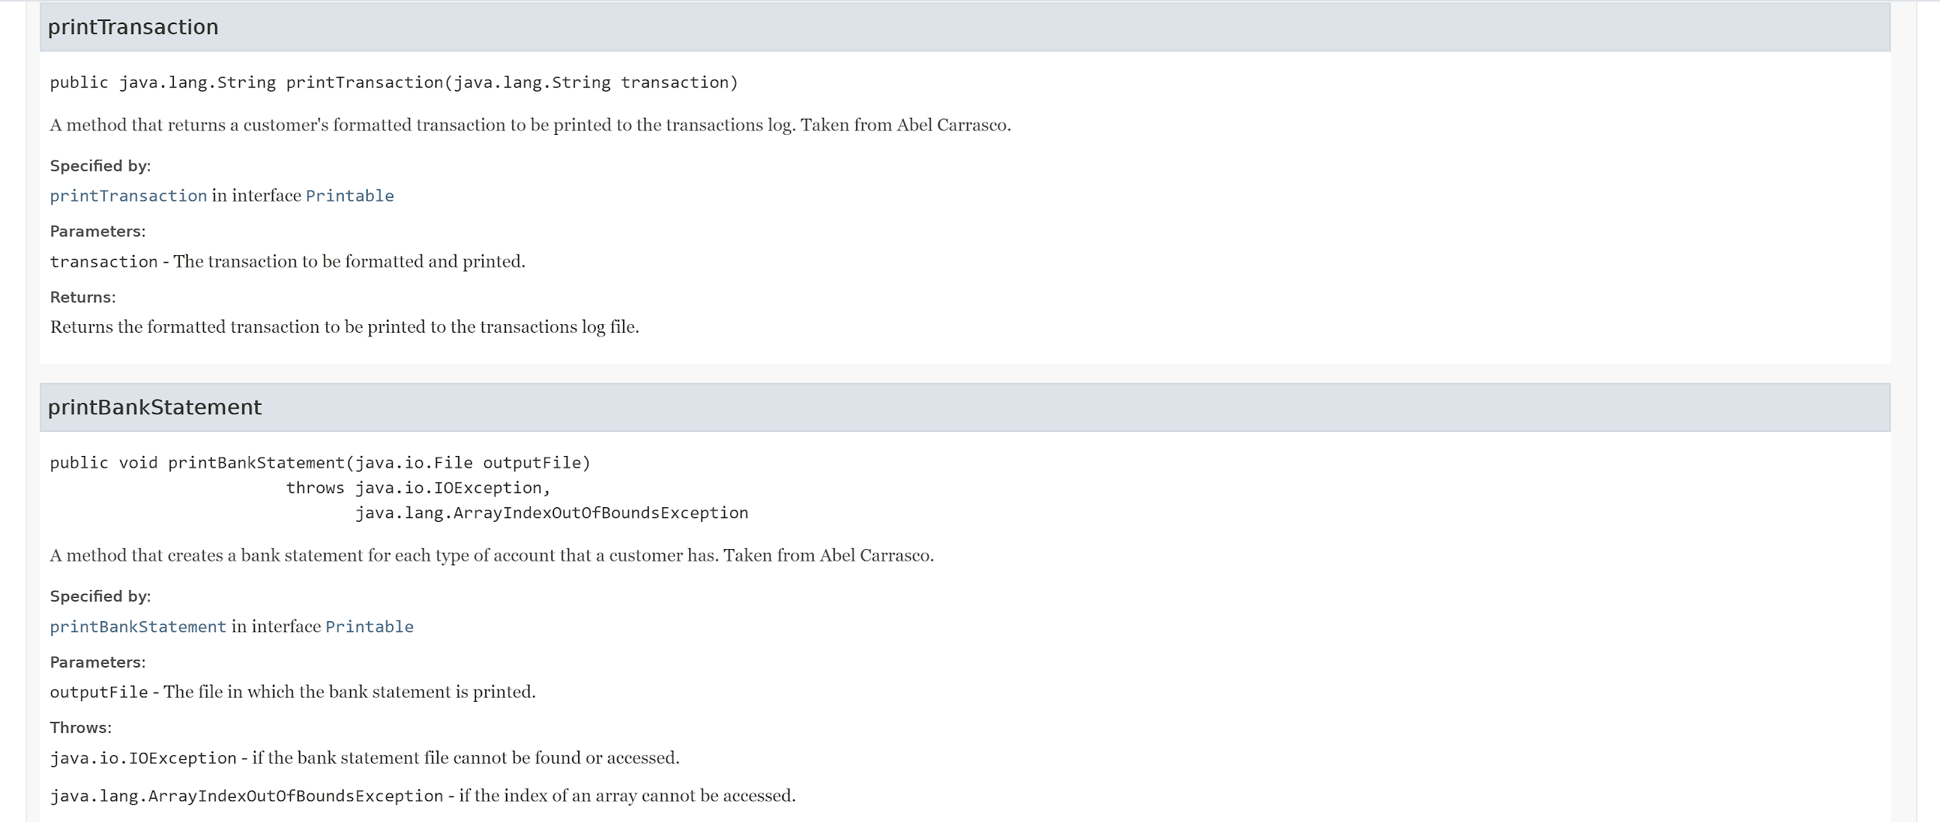
Javadoc - Customer (Part 10)

Slide 16
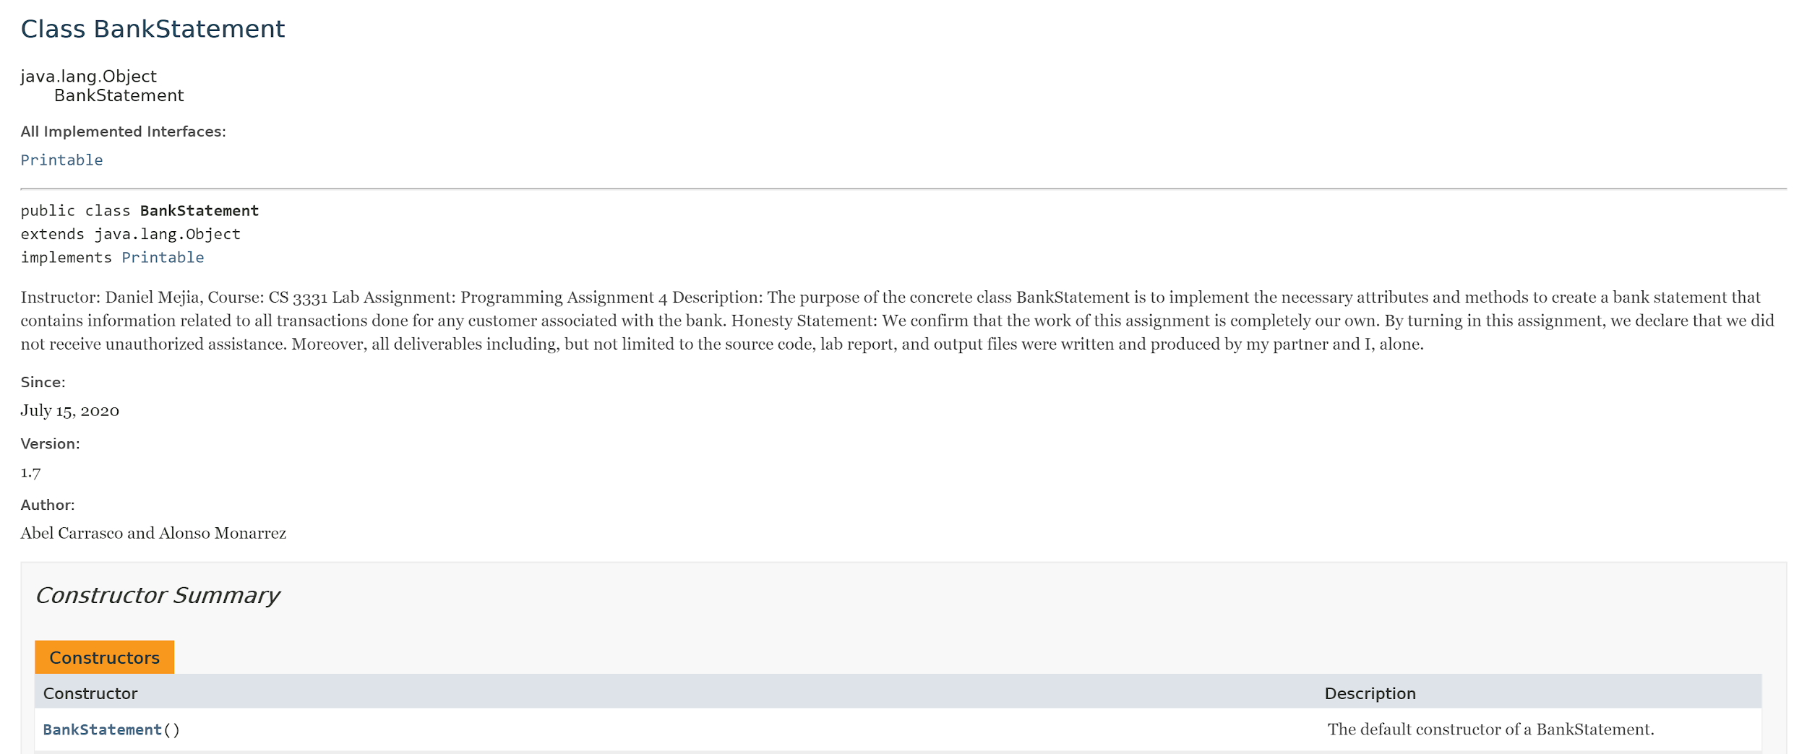
Javadoc - BankStatement (Part 1)

Slide 17
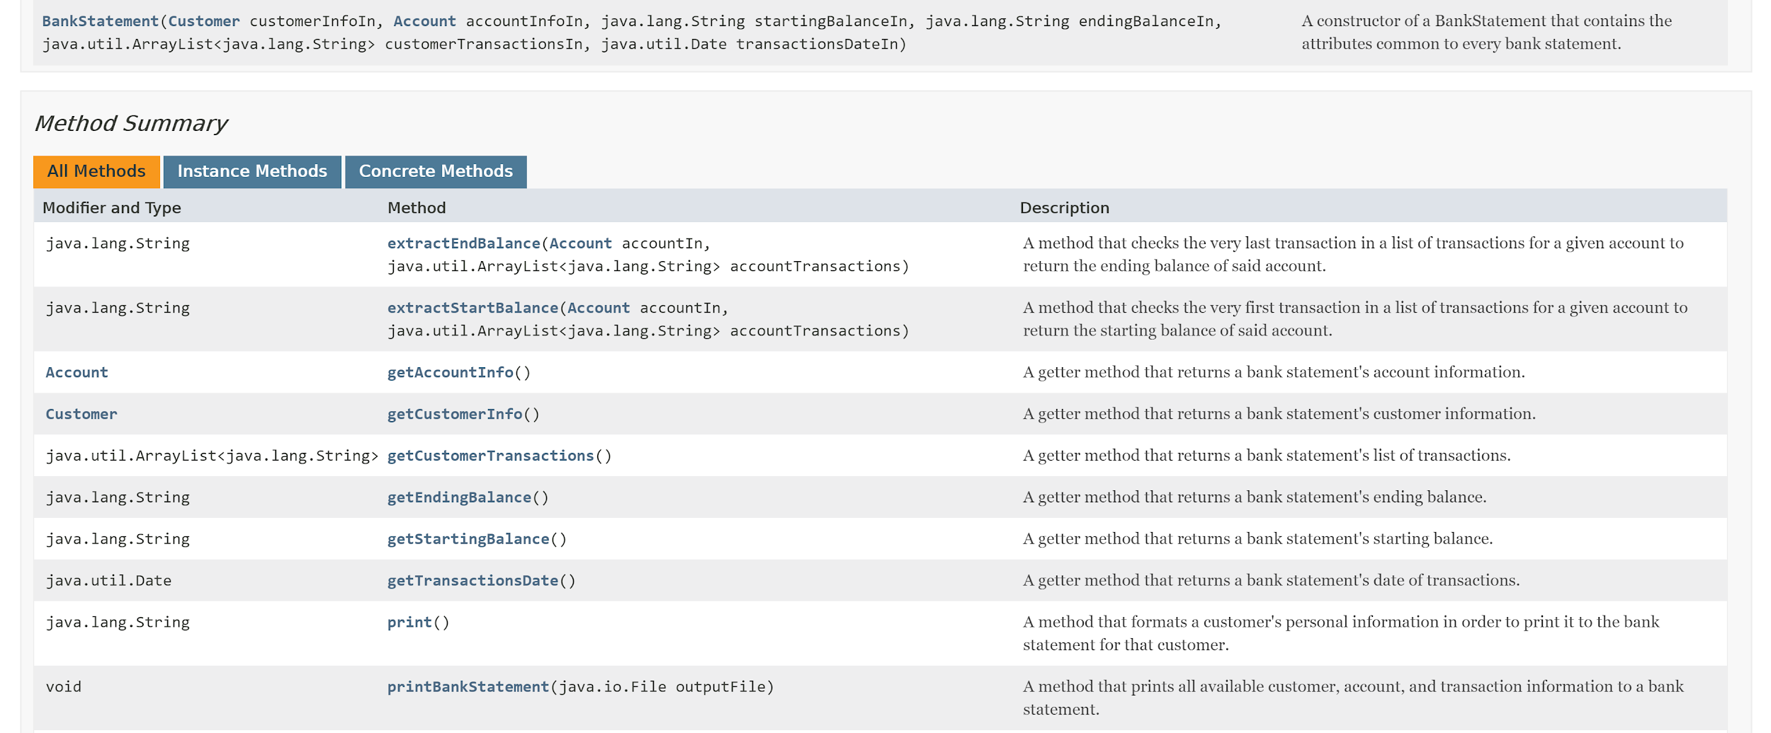
Javadoc - BankStatement (Part 2)

Slide 18
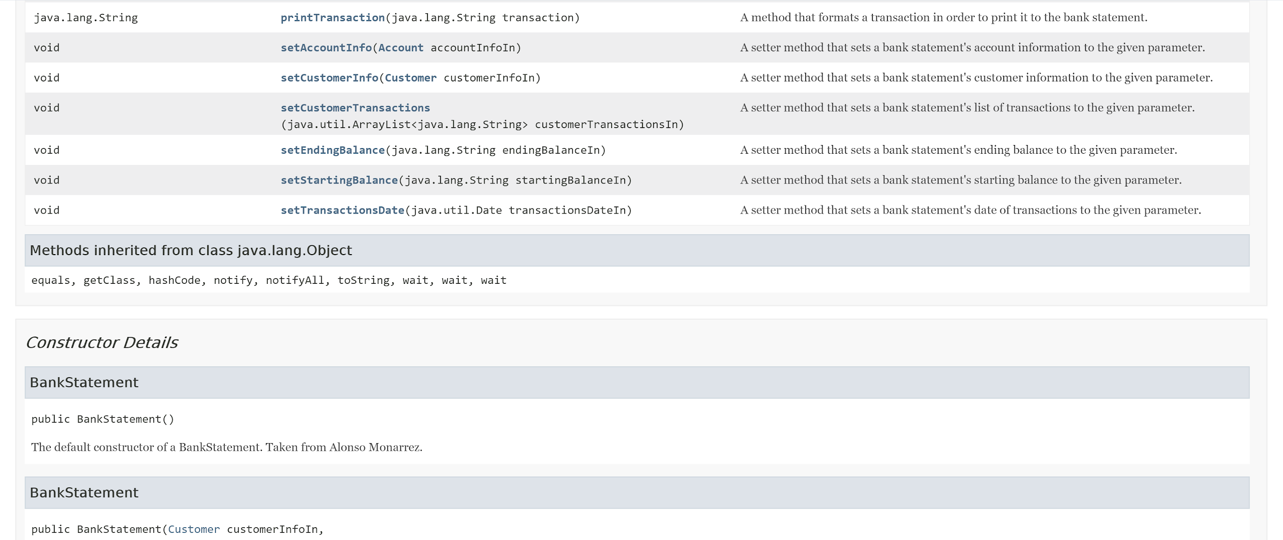
Javadoc - BankStatement (Part 3)

Slide 19
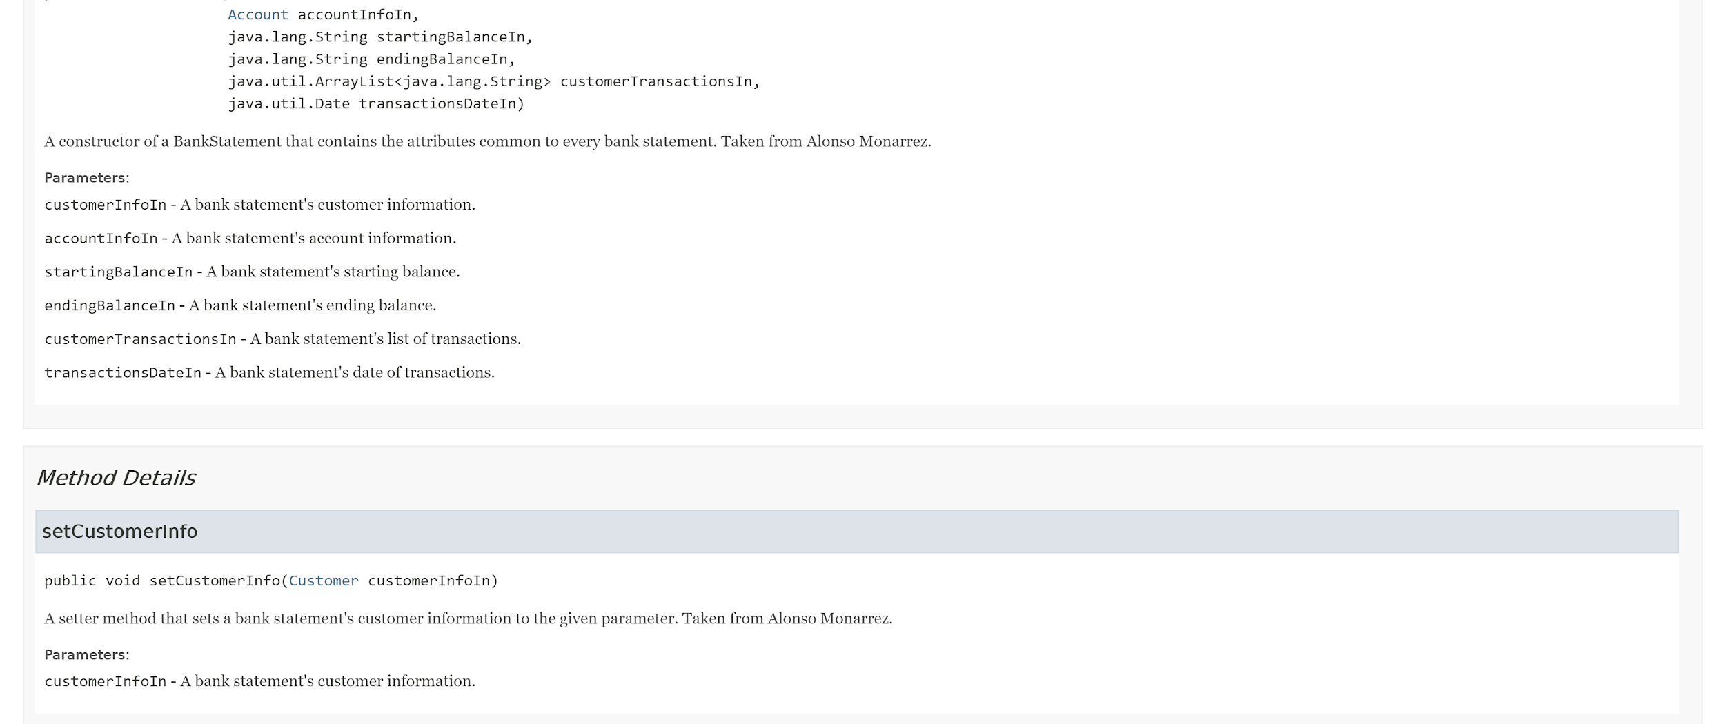
Javadoc - BankStatement (Part 4)

Slide 20
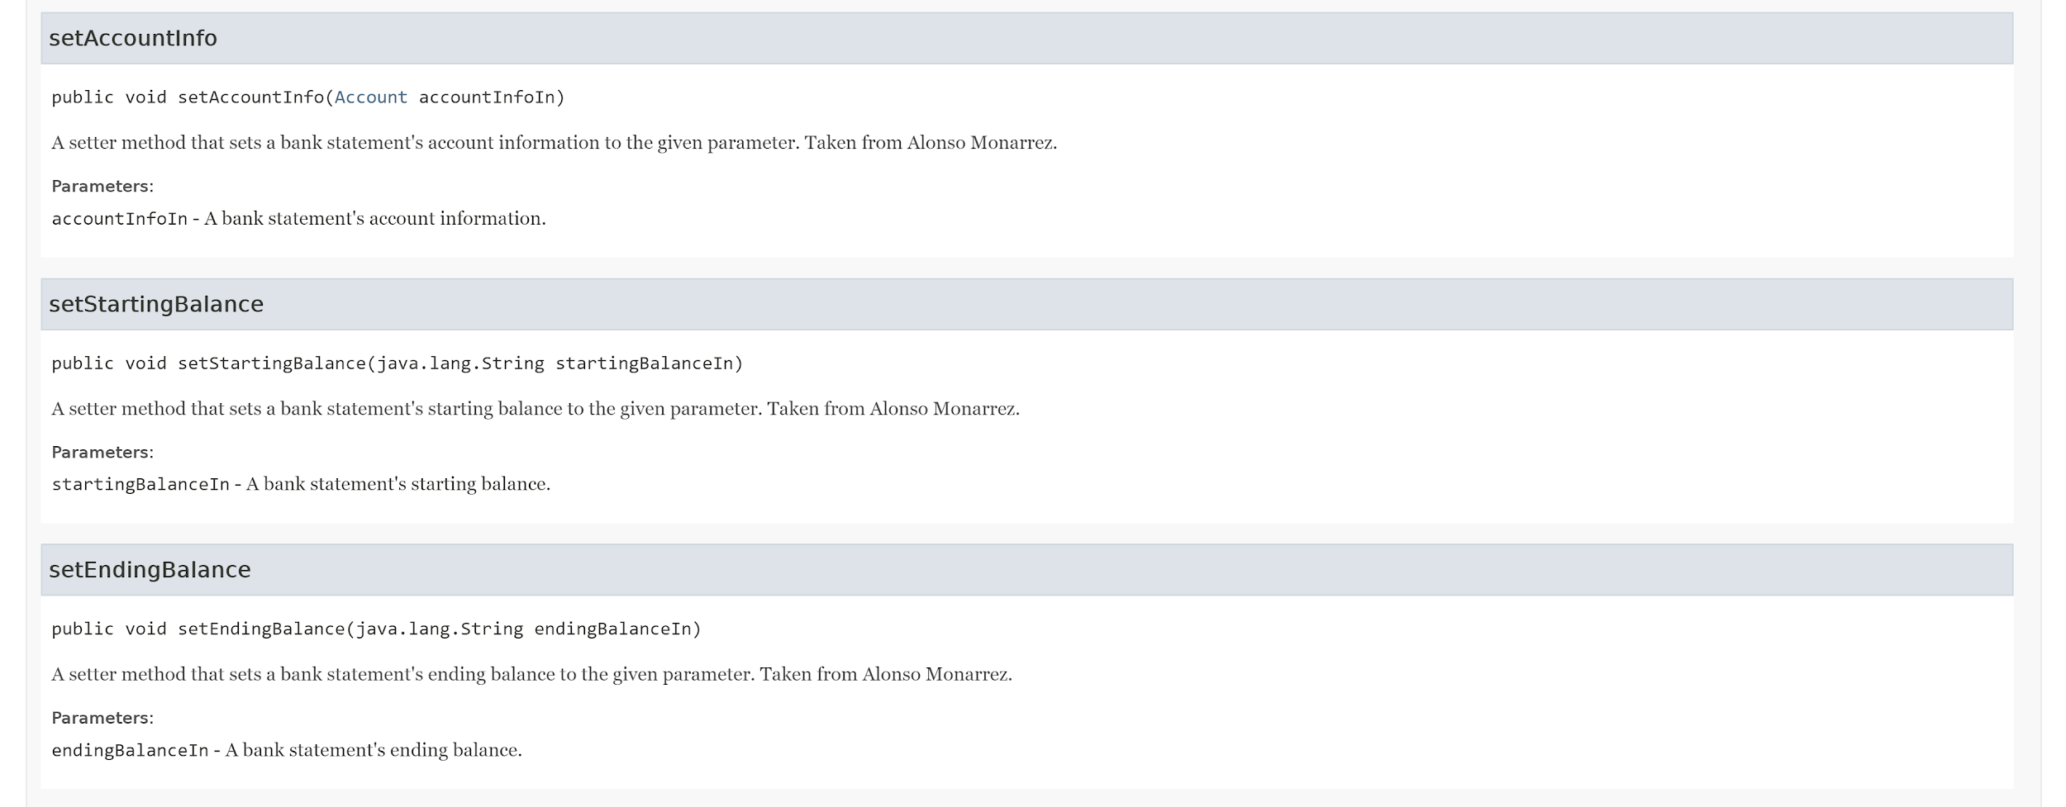
Javadoc - BankStatement (Part 5)

Slide 21
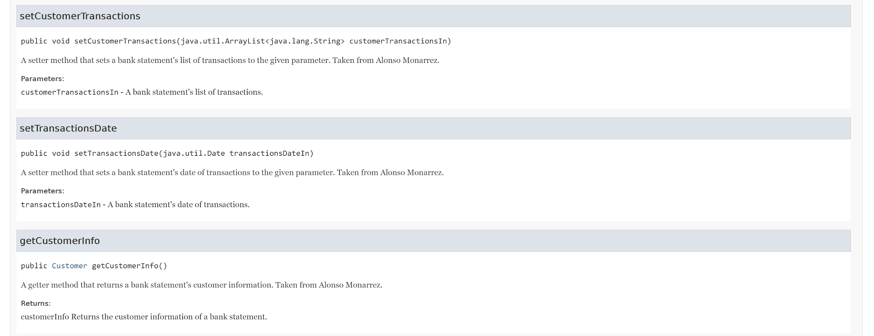
Javadoc - BankStatement (Part 6)

Slide 22
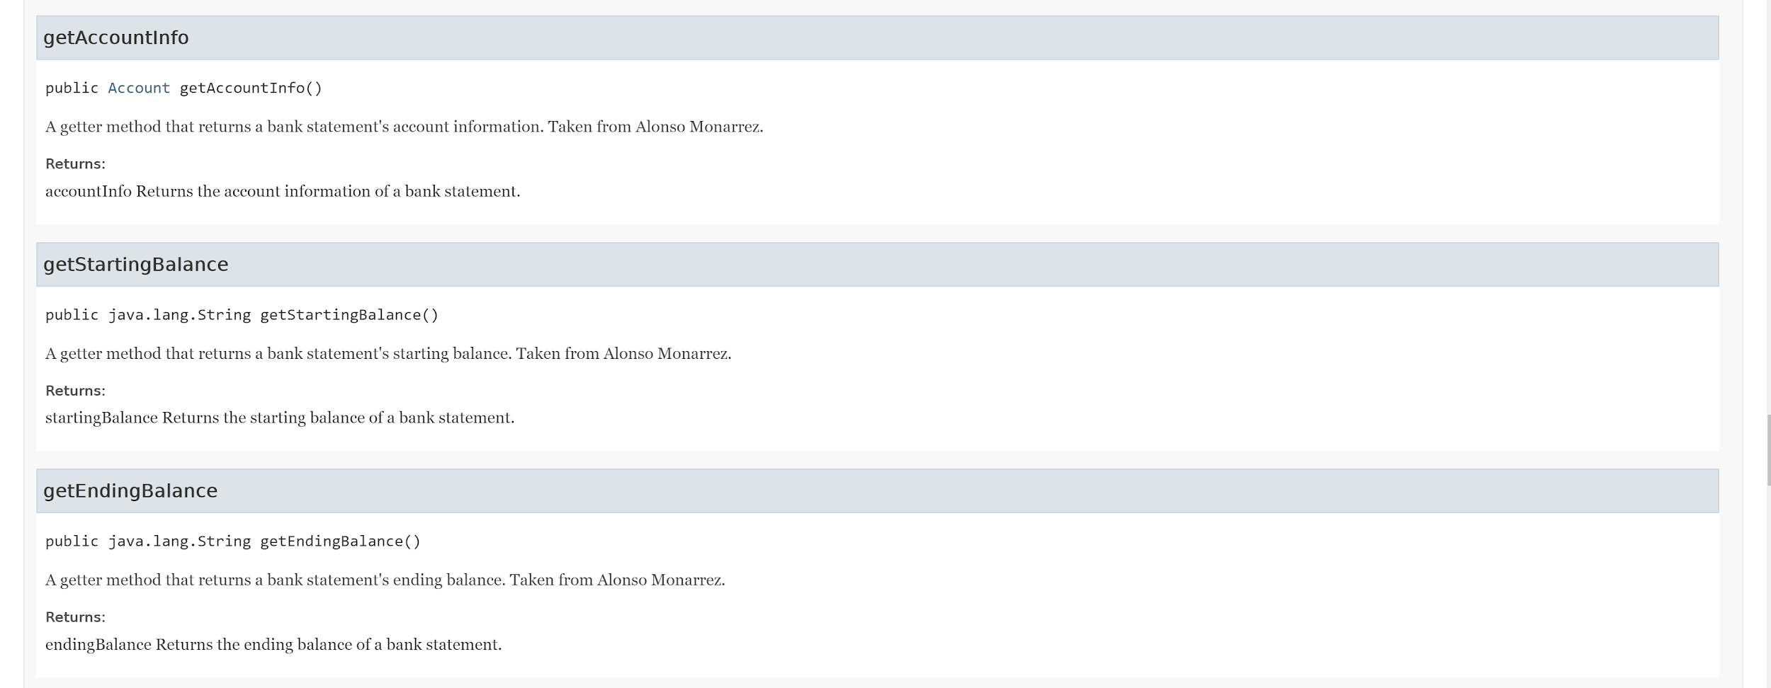
Javadoc - BankStatement (Part 7)

Slide 23
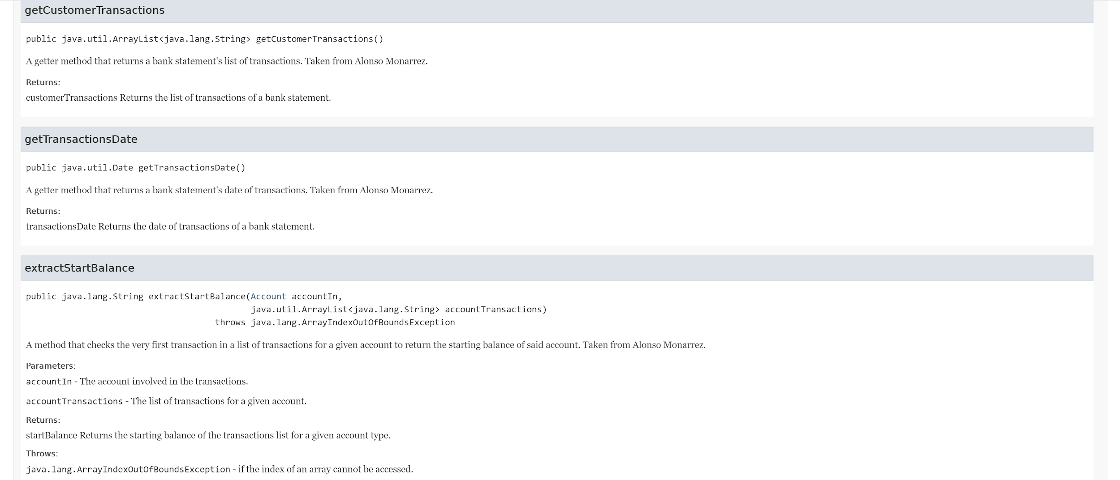
Javadoc - BankStatement (Part 8)

Slide 24
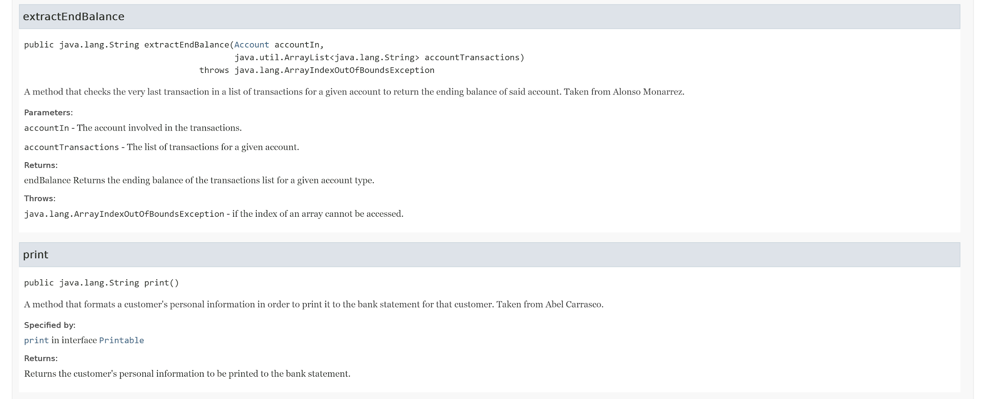
Javadoc - BankStatement (Part 9)

Slide 25
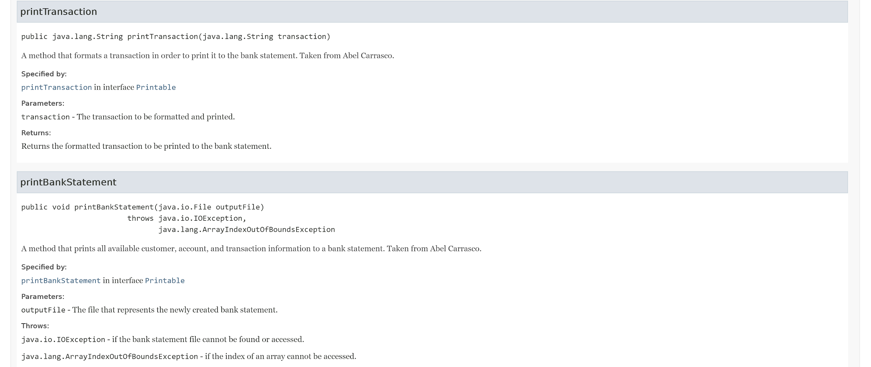
Javadoc - BankStatement (Part 10)

Slide 26
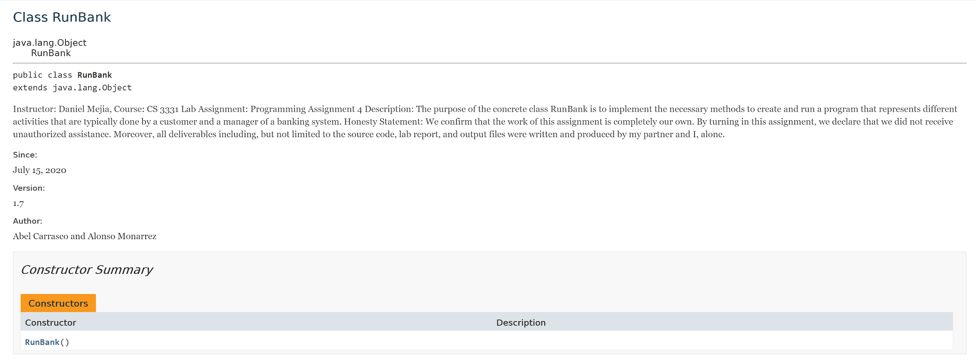
Javadoc - RunBank (Part 1)

Slide 27
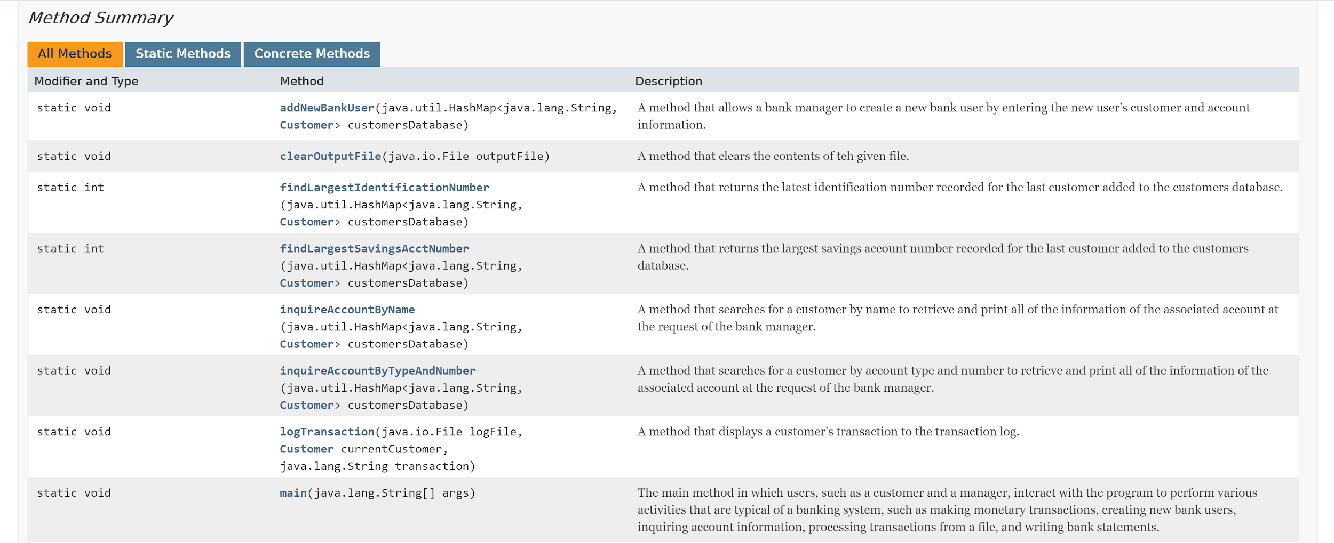
Javadoc - RunBank (Part 2)

Slide 28
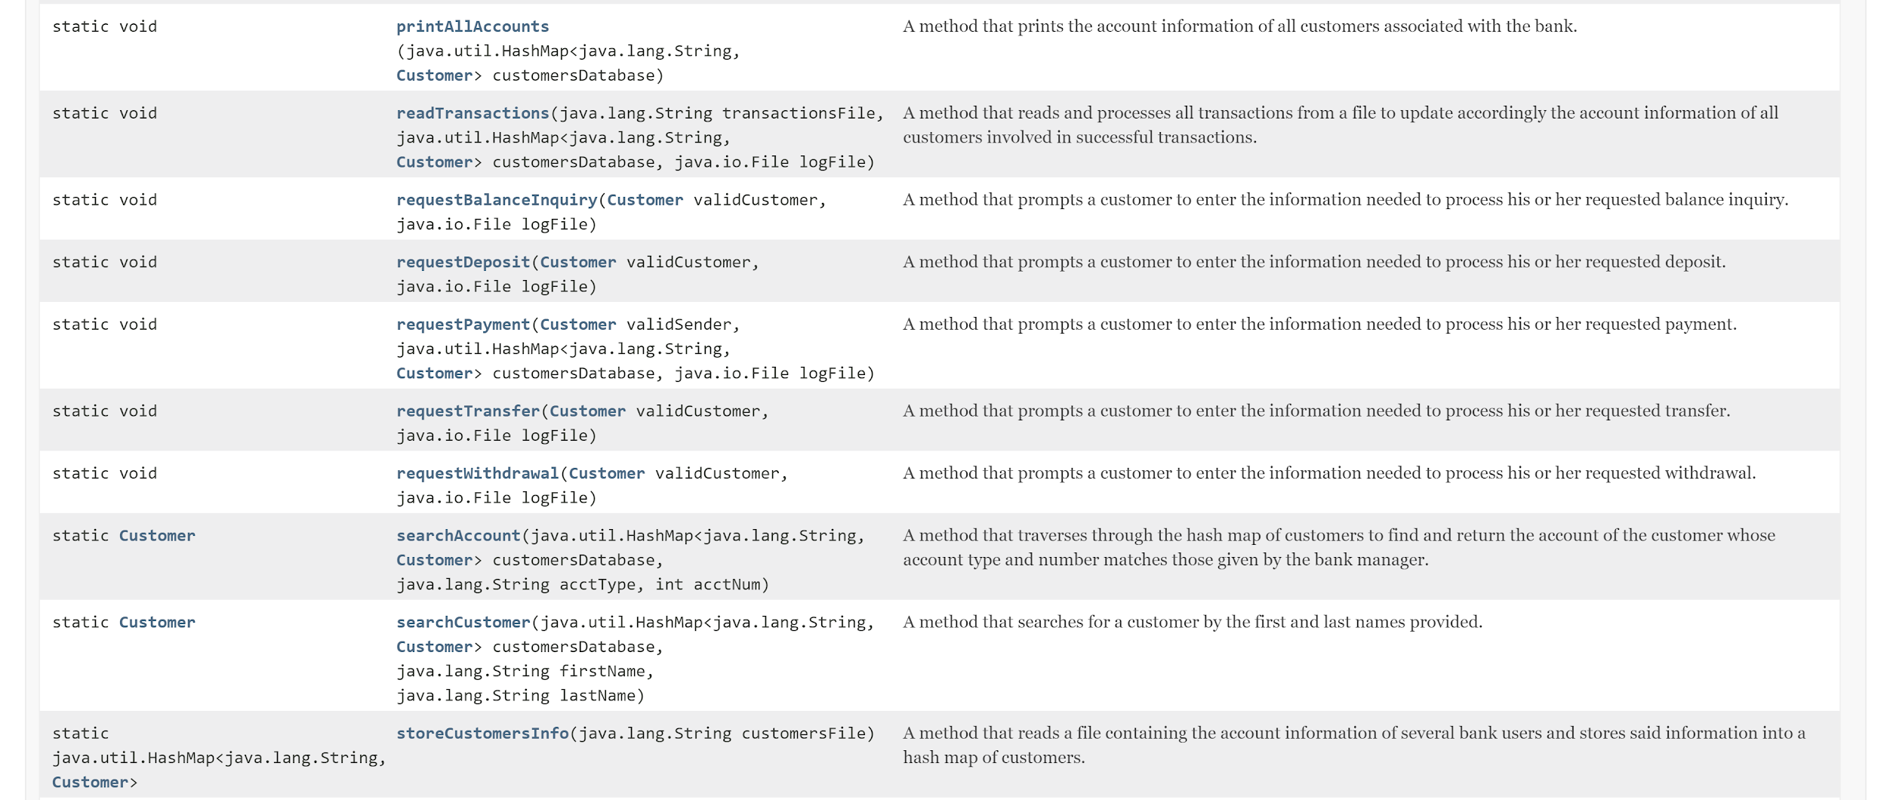
Javadoc - RunBank (Part 3)

Slide 29
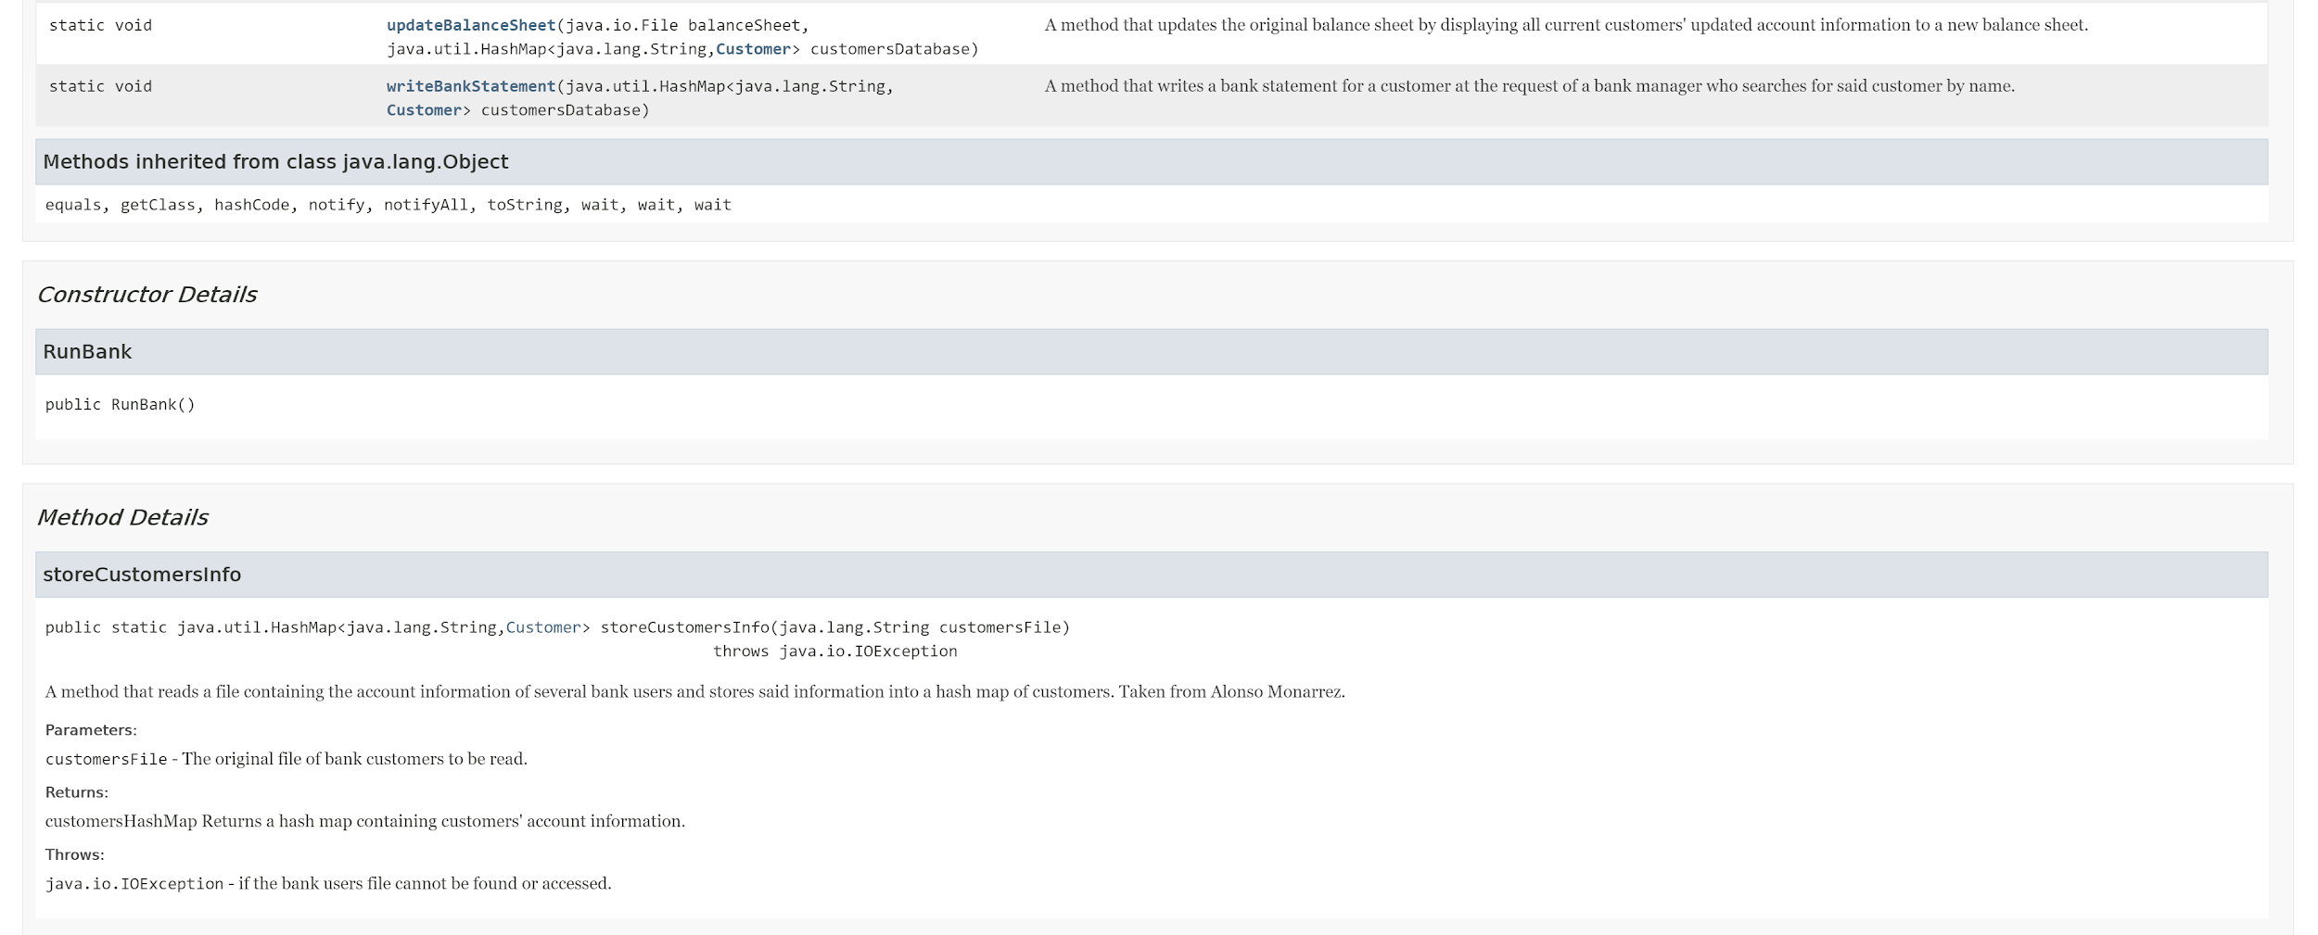
Javadoc - RunBank (Part 4)

Slide 30
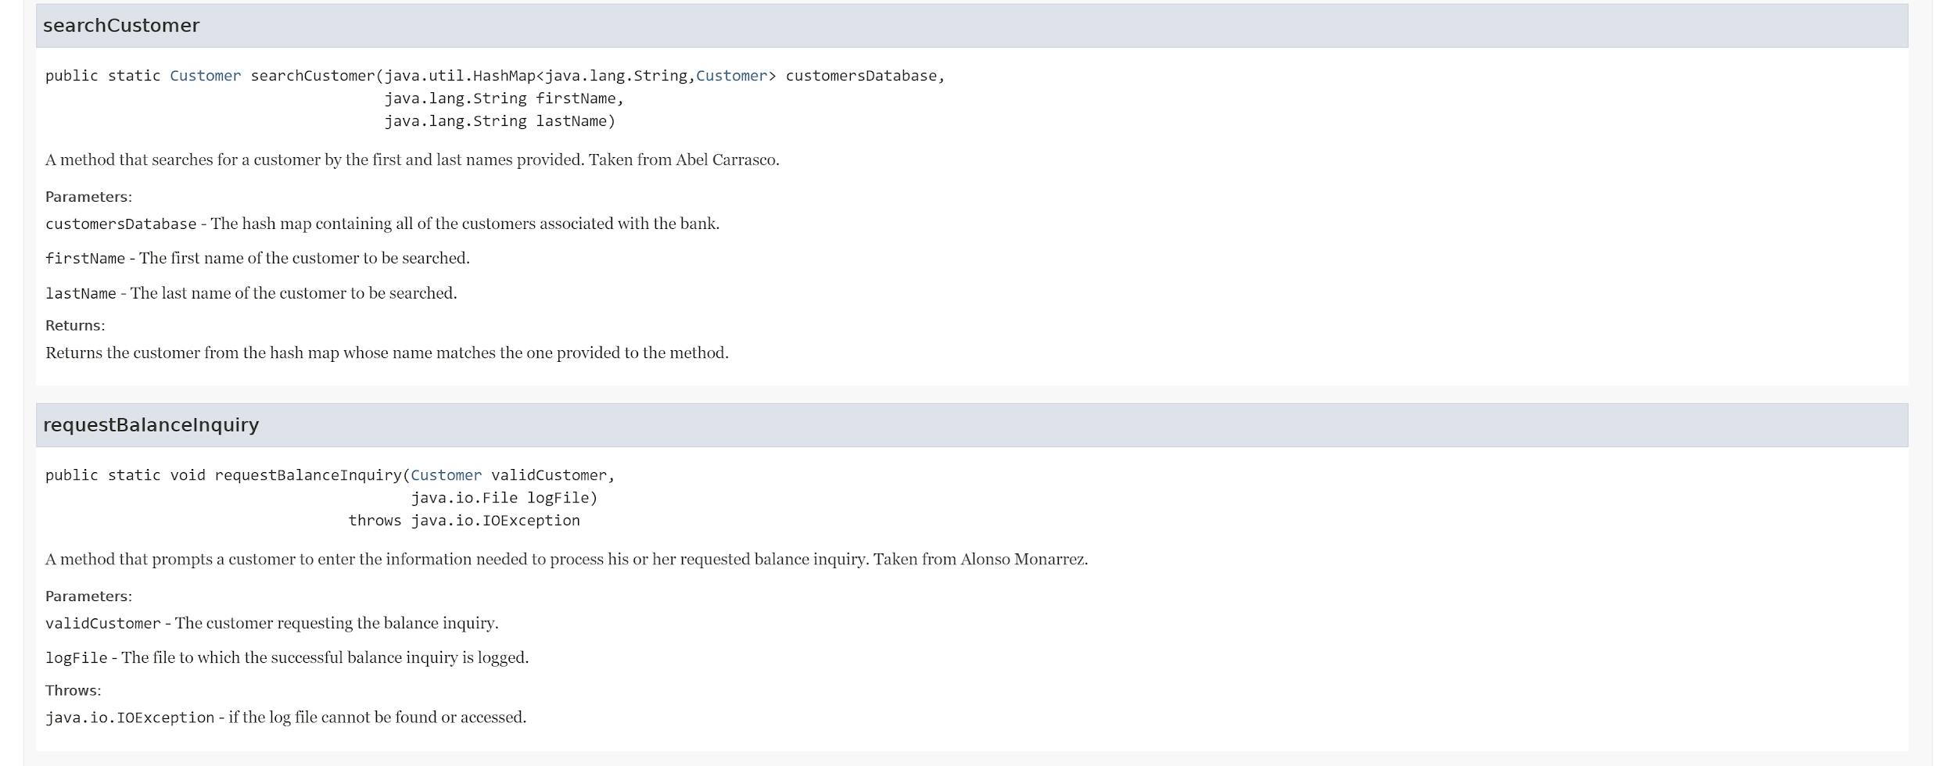
Javadoc - RunBank (Part 5)

Slide 31
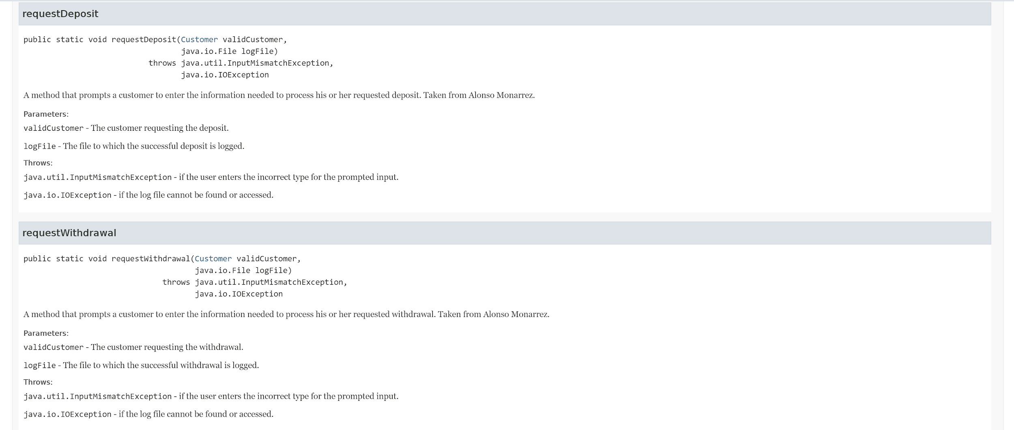
Javadoc - RunBank (Part 6)

Slide 32
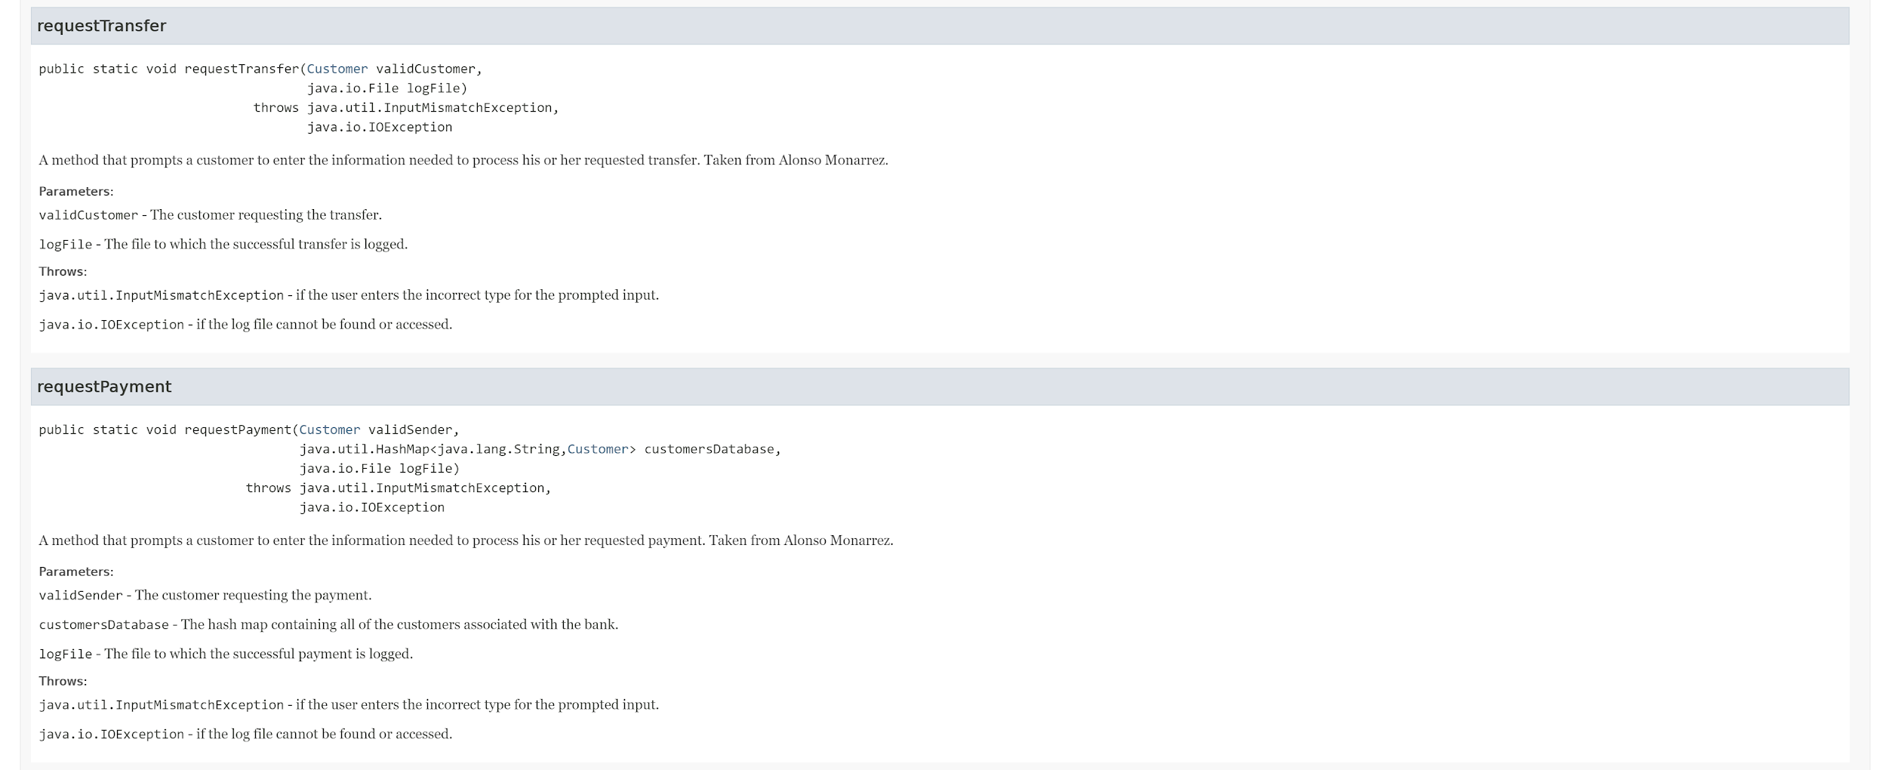
Javadoc - RunBank (Part 7)

Slide 33
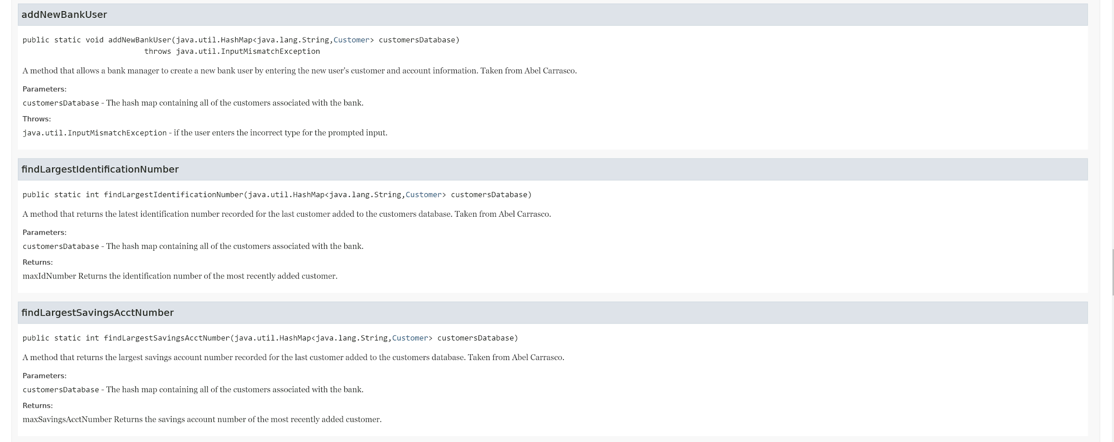
Javadoc - RunBank (Part 8)

Slide 34
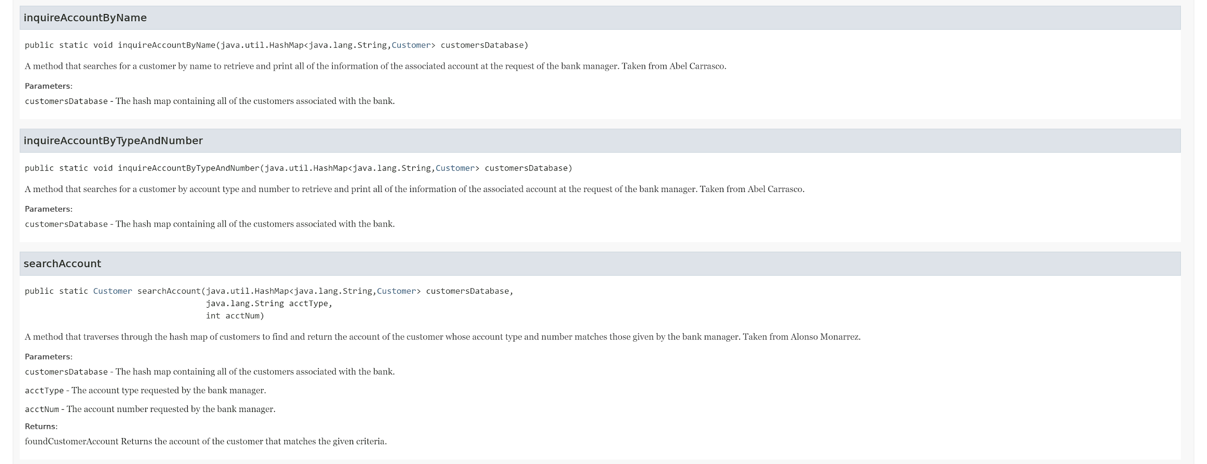
Javadoc - RunBank (Part 9)

Slide 35
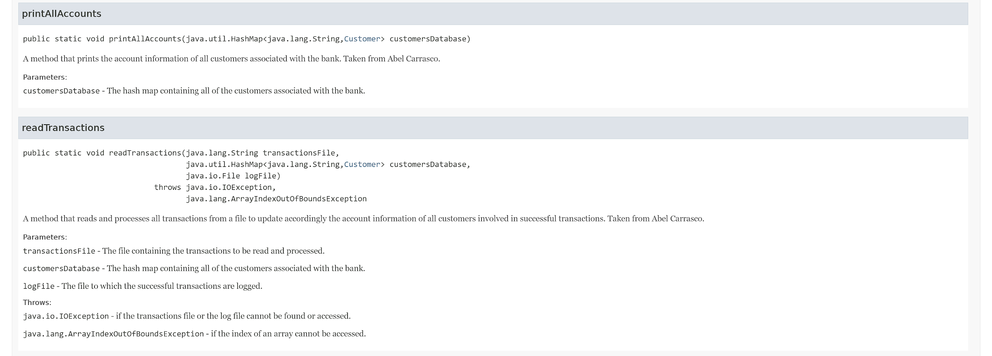
Javadoc - RunBank (Part 10)

Slide 36
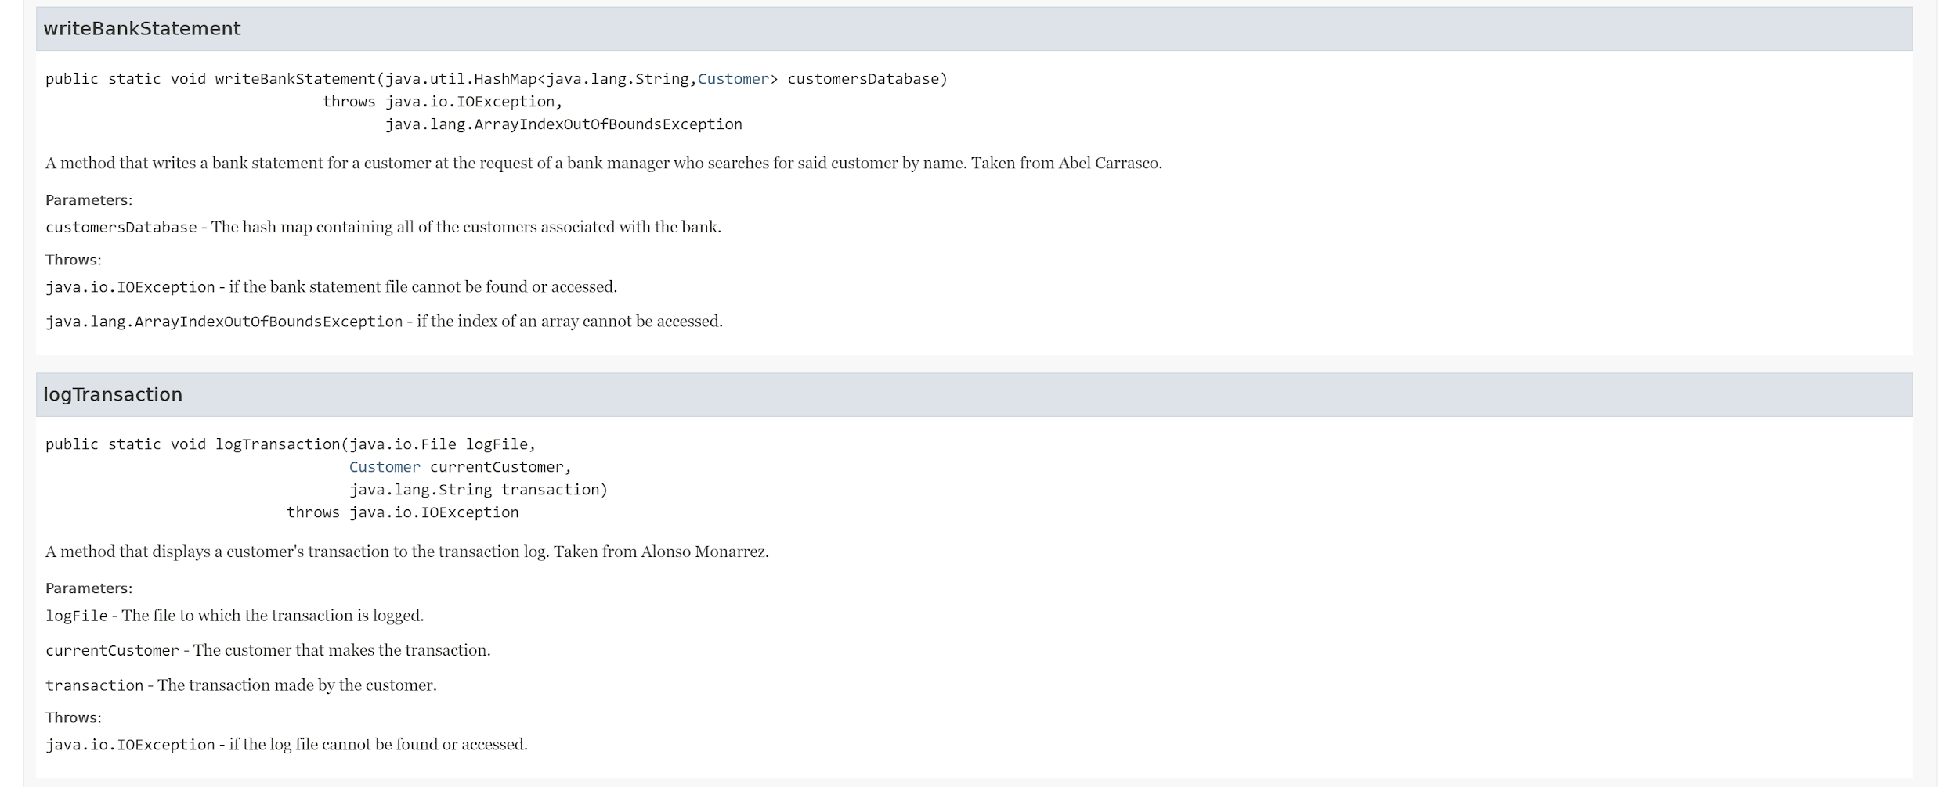
Javadoc - RunBank (Part 11)

Slide 37
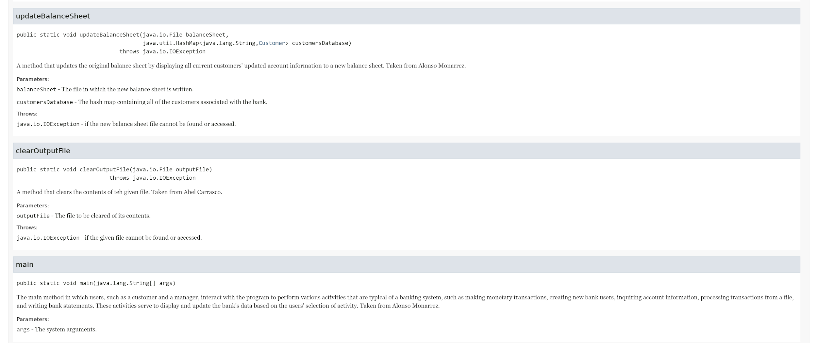
Javadoc - RunBank (Part 12)

Slide 38
Reflections
From the bank assignments, we learned that refactoring is a useful practice that allows us to repurpose our existing code without needing to rebuild it from the ground up or change its main functionality.
We grew as a student by understanding the importance of managing our time efficiently, especially when we had to work together on a somewhat tight schedule.
To complete this task, we broke up the problem by first communicating with each other to discuss our assigned duties and how we were going to manage them. Once we were done writing a method based on what we discussed, we would show that method to each other and explain how and why it worked to solve a certain aspect of the problem. Afterwords, we would try to combine our methods into one that worked properly. If it did, then we would leave it as is. Otherwise, we would edit it to how it should be until it is incorporated correctly into our code.

Slide 39
References
Kaleem, D., & Mandal, A. (2018, December 11). Sorting a HashMap According to Keys in Java. GeeksforGeeks. https://www.geeksforgeeks.org/sorting-hashmap-according-key-value-java/.
Seidl, M., Scholz, M., Huemer, C., & Kappel, G. (2015). Chapter 4: The Class Diagram. In UML @ Classroom: An Introduction to Object-Oriented Modeling (pp. 60). essay, Springer.
Sun, K. (2008, December). Online Diagram Software & Visual Solution. Lucidchart. https://www.lucidchart.com/.

